Slide 1
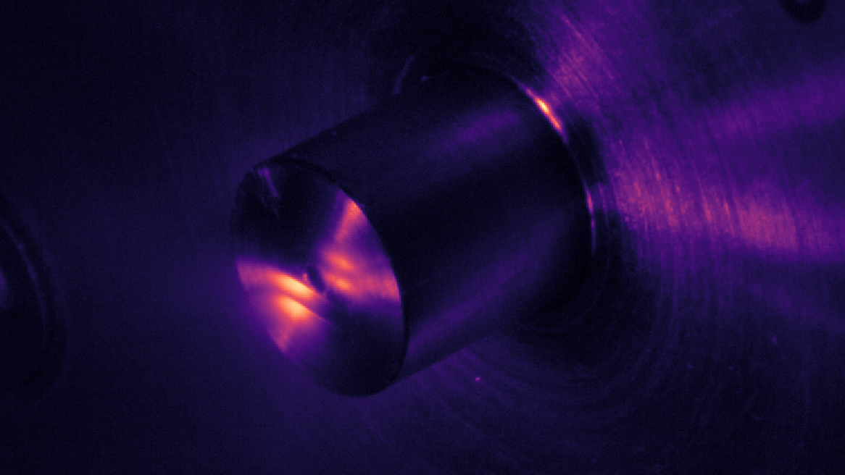
Complex Attosecond Transient-absorption
Spectroscopy
Stephen J. Hageman
Agostini-DiMauro Ultrafast Atomic Physics Research Group
Ph.D. Dissertation Defense
Dec. 8, 2020

Slide 2
Academic History
B.S. Physics and Mathematics, Johns Hopkins University……………………………………………………….................
Entered OSU physics graduate program………………………………………………………….........................................
Completed candidacy exam……………………………………………………………………………………………………………….....
M.S. Physics, OSU…………………………………………………………………………………………………………………………………..
2011
2012
2014
2014
Publication List
Cr:ZnSe mid-IR, multi-mJ, few-cycle amplifier: a new platform for attosecond soft-X-ray physics
V. E. Leshchenko, B. K. Talbert, Y. H. Lai, S. Li, Y. Tang, S. J. Hageman, G. Smith, P. Agostini, L. F. DiMauro, and C. I. Blaga, Optica 7 (8), 981-988 (2020)
High relative-phase precision beam duplicator for mid-infrared femtosecond pulses
A. Camper, H. Park, S. J. Hageman, G. Smith, T. Auguste, P. Agostini, and L. F. DiMauro, Optics Letters, 44 (22), 5465-5468 (2019)
Epitaxial films of Heusler compound Co₂FeAl_{0.5}Si_{0.5} with high crystalline quality grown by off-axis sputtering
B. Peters, A. Alfonsov, C. G. F. Blum, S. J. Hageman, P. M. Woodward, S. Wurmehl, B. Büchner, and F. Y. Yang, Appl. Phys. Lett. 103, 162404 (2013)
Parallel fabrication of magnetic tunnel junction nanopillars by nanosphere lithography
W. G. Wang, A. Pearse, M. Li, S. Hageman, A. X. Chen, F. Q. Zhu, and C. L. Chien, Scientific Report 3, 1948 (2013)
Electric-field-assisted switching in magnetic tunnel junctions
W. G. Wang, M. Li, S. Hageman, and C. L. Chien, Nature Mater. 11, 64 (2012)
Thermal annealing study of magnetoresistance and perpendicular anisotropy in magnetic tunnel junctions based on MgO and CoFeB
W. G. Wang, S. Hageman, M. Li, S. X. Huang, X. M. Kou, X. Fan, J. Q. Xiao, and C. L. Chien, Appl. Phys. Lett. 99, 102502 (2011)

Slide 3
Outline
Introduction: Attosecond transient-absorption spectroscpy
Experimental Apparatus: Transient absorption beamline (TABLe)
Experimental Investigations
Two-source High Harmonic Generation using a square-wave phase grating (SWPG)
Measurement of Refractive Index using a SWPG
Attosecond Transient-absorption spectroscopy of argon Fano resonances
Complex Attosecond Transient-absorption Spectroscopy

Slide 4
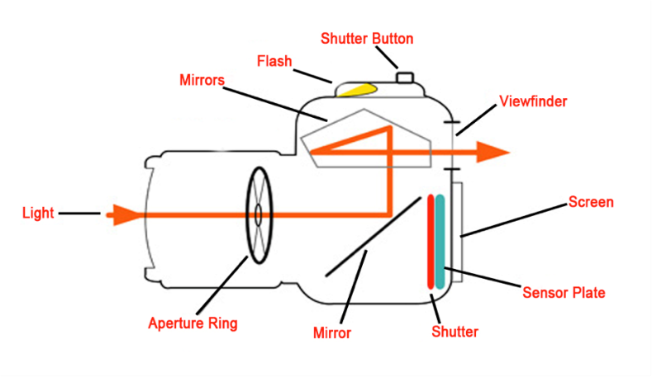
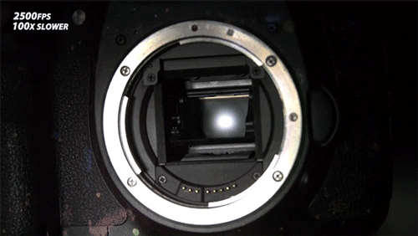
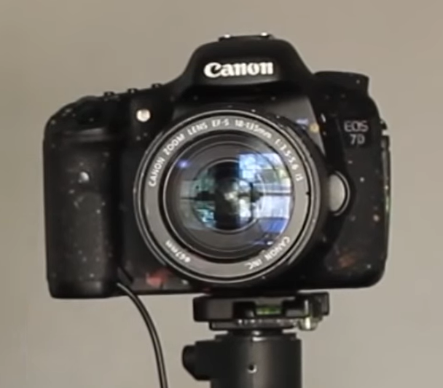
Introduction: measuring fast events
How can you study the shutter mechanism of a DSLR camera, using a DSLR?
What shutter speed would you need?
Your shutter speed needs to be faster than what you want to study!

Slide 5
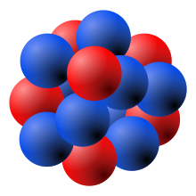
Introduction: measuring fast events
How about motion of electrons in an atom?
Electron orbits hydrogen nucleus 6.67 x 10¹⁵ times per second, every 150 as (10⁻¹⁸ s)
To see this, you would need a “shutter” speed faster that 1/150 as⁻¹
This can be done using lasers!

Slide 6
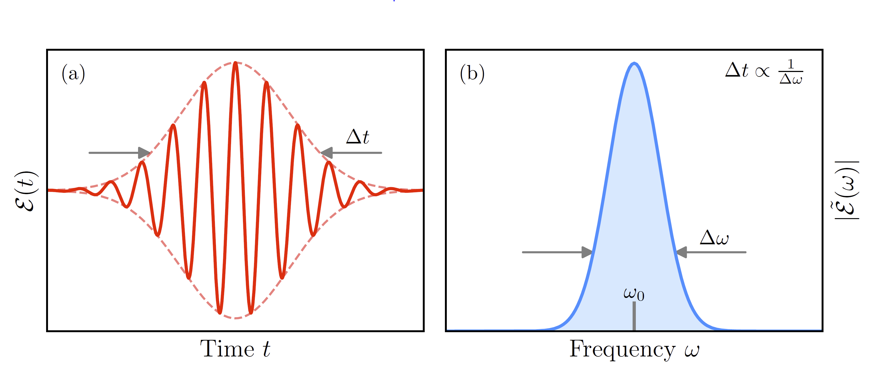
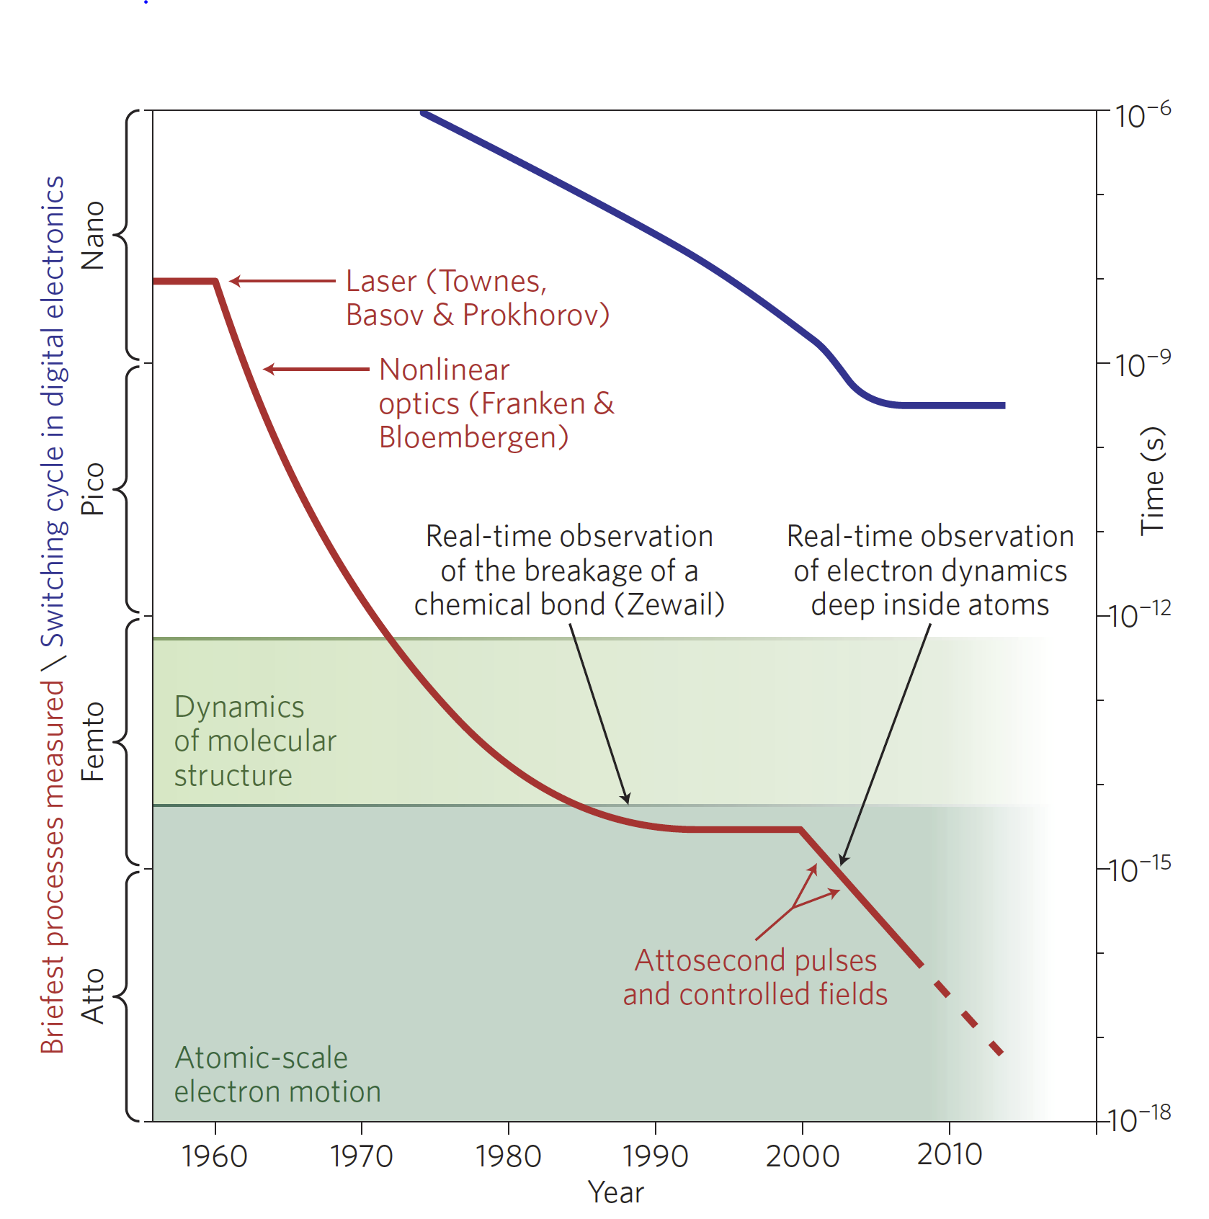
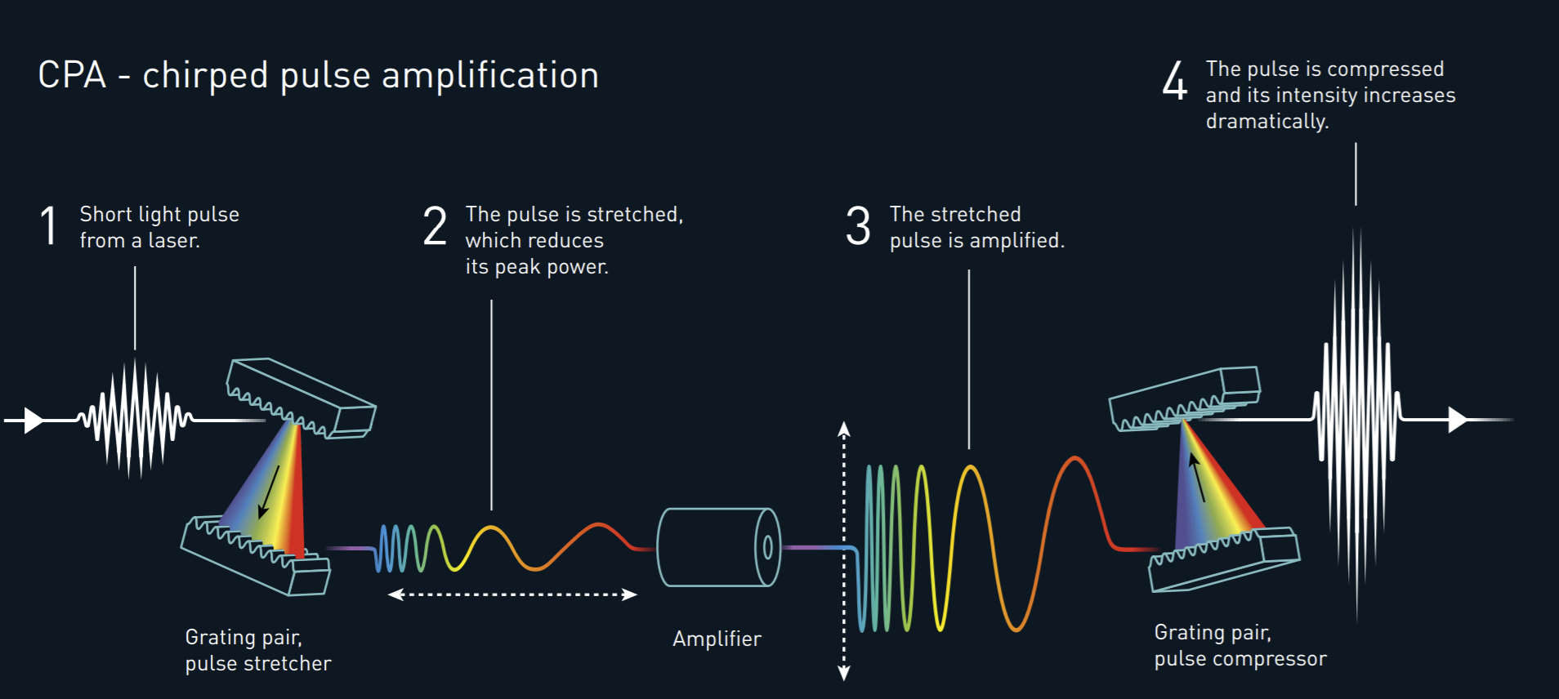
Ultrashort Laser Pulses
Ultrashort laser pulses are characterized by their pulse duration Δt and bandwidth Δω
Great effort has been made to reduce the pulse duration, enabling new observations
Modern CPA laser systems can directly produce laser pulses that have a pulse duration as small as a few femtoseconds (10⁻¹⁵ s)
To get beyond this, high-harmonic generation can be used to generate attosecond pulses

Slide 7
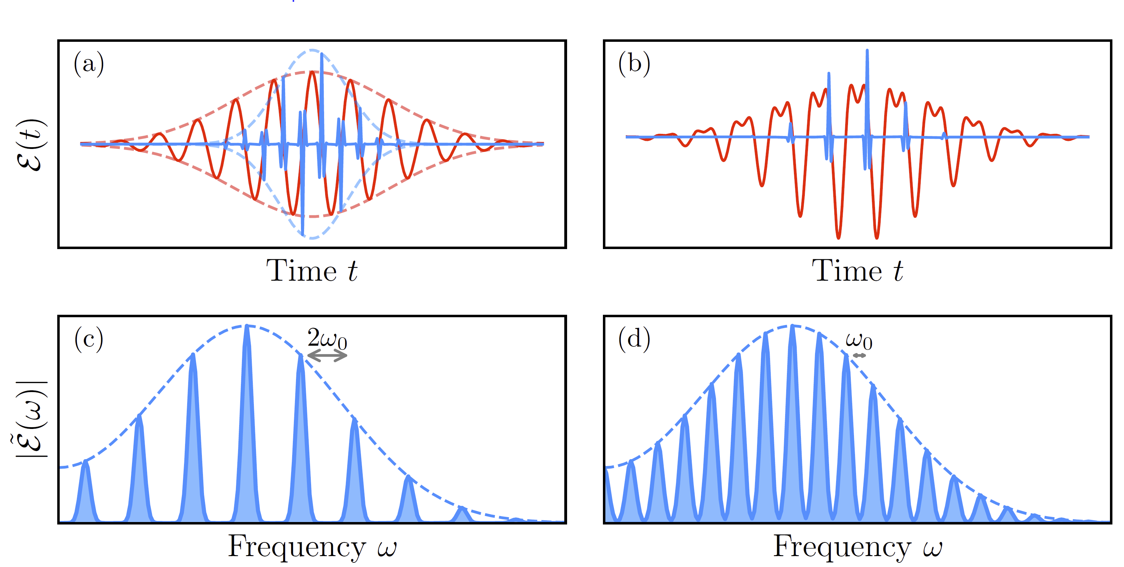
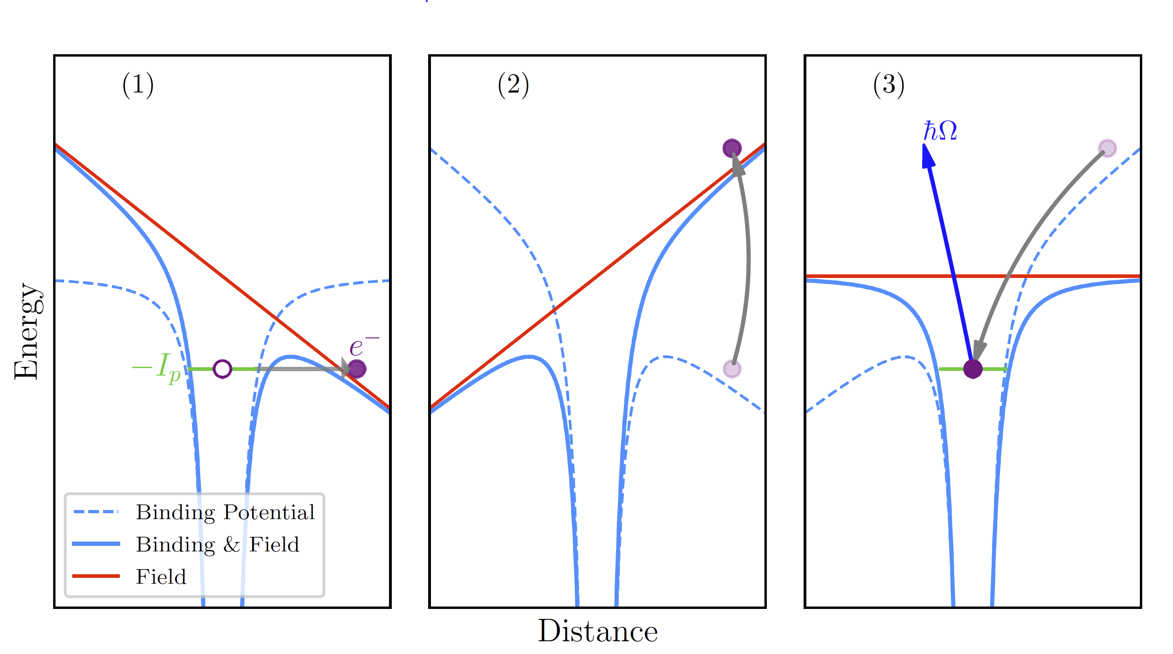
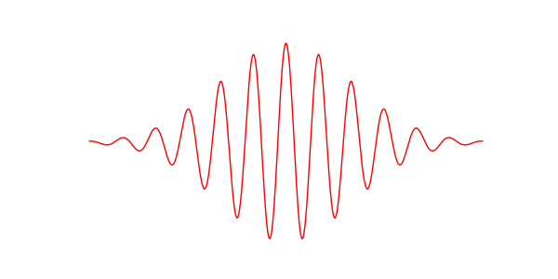
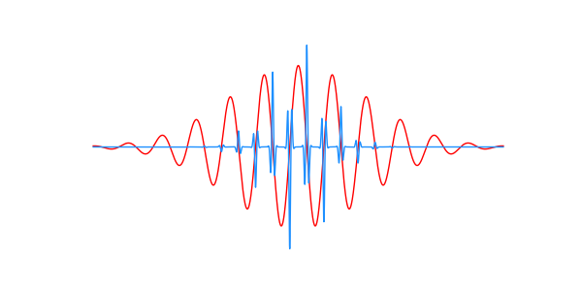
Introduction to high-harmonic generation (HHG)
Ionization
Propagation
Recombination
HHG can be used to generate pulses with bandwidth in the XUV (up to hundreds of eV)
Describe by a 3-step model
Naturally produces an attosecond pulse train (APT)
Characterized by odd harmonics of the fundamental in the frequency domain
Gas
IR
XUV

Slide 8

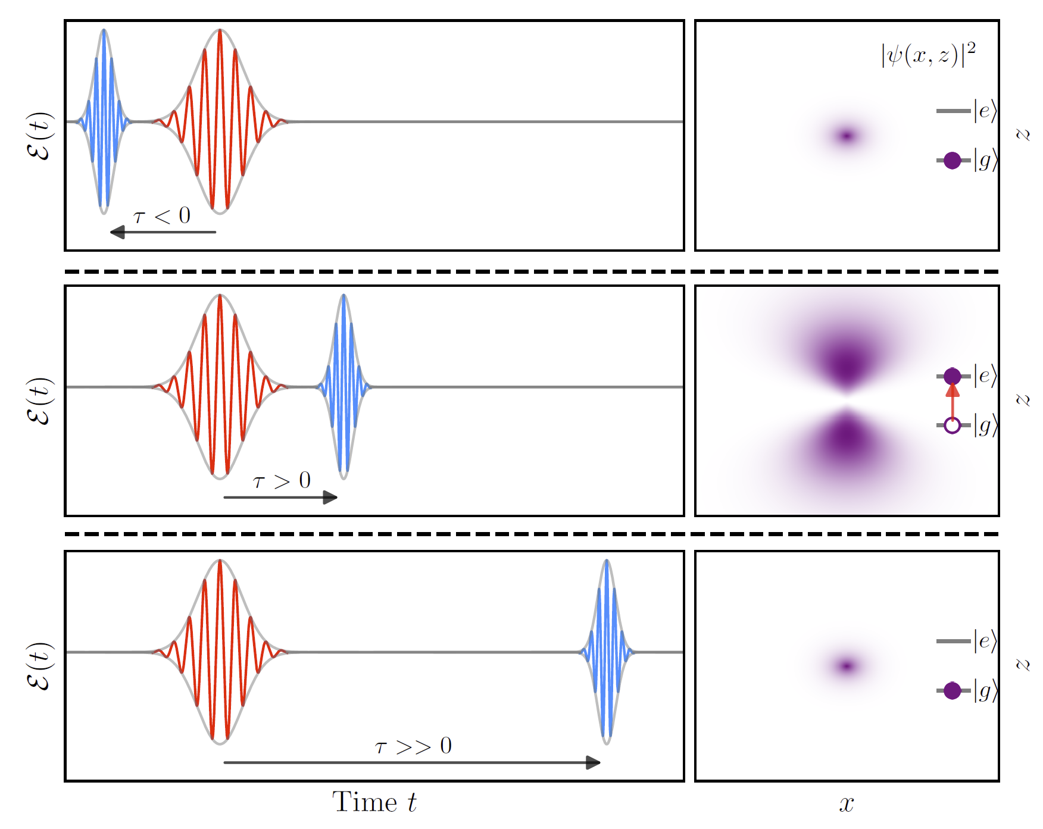
Introduction to pump-probe techniques
Can be used to extract dynamics of a system in a pump-probe experiment
Pump pulse is used to modify the system of interest → Probe pulse follows at a variable time delay
XUV APT generally serves as the probe, and the pump is a replica of the pulse used to generate the APT

Slide 9
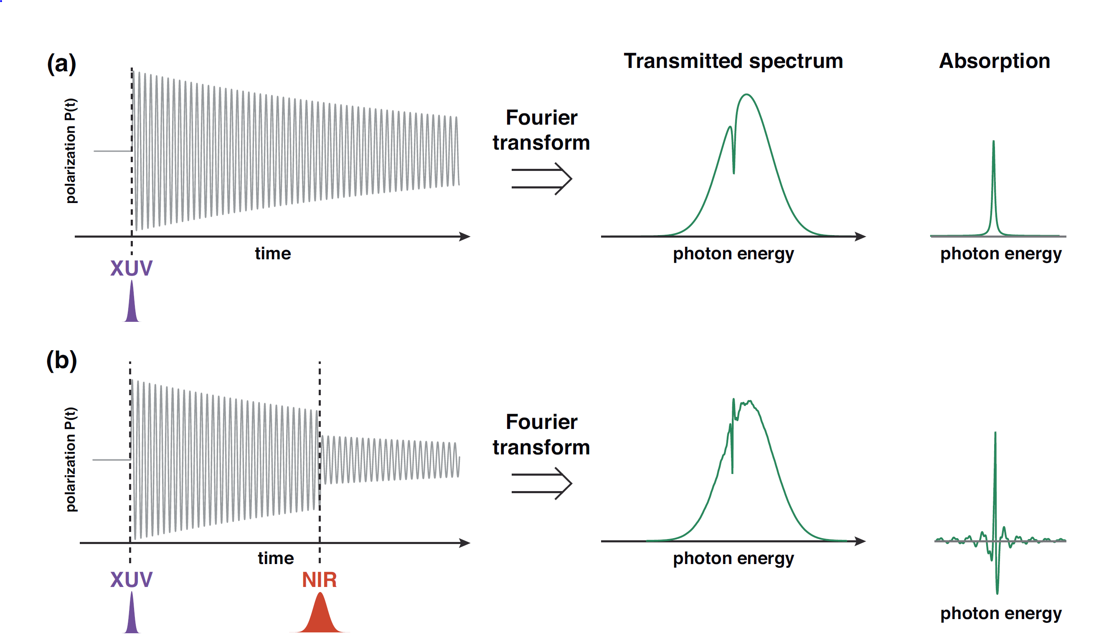
Attosecond transient absorption spectroscopy in gases
XUV induces a polarization in a gas medium
Polarization is macroscopic sum of oscillating dipoles which emit light that interferes with transmitted XUV ➔ absorption feature
An additional pulse perturbs this polarization through interactions with sample ➔ modified absorption feature
By measuring the delay dependent absorption, dynamics can be extracted

Slide 10
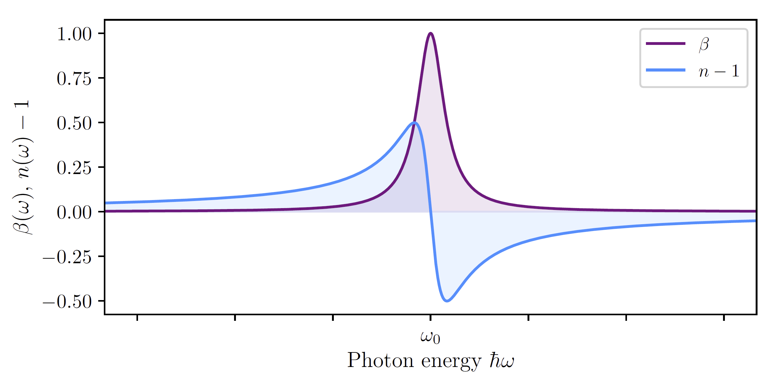
Attosecond transient absorption spectroscopy in gases
Change in absorption → ATS
Change in dispersion → CATS
Generally, absorption is accompanied by dispersion
Without the IR pulse, there are known methods to measure the absorption and dispersion
ATS measures the change in absorption due the IR pulse
CATS measures the change in dispersion due to the IR pule

Slide 11
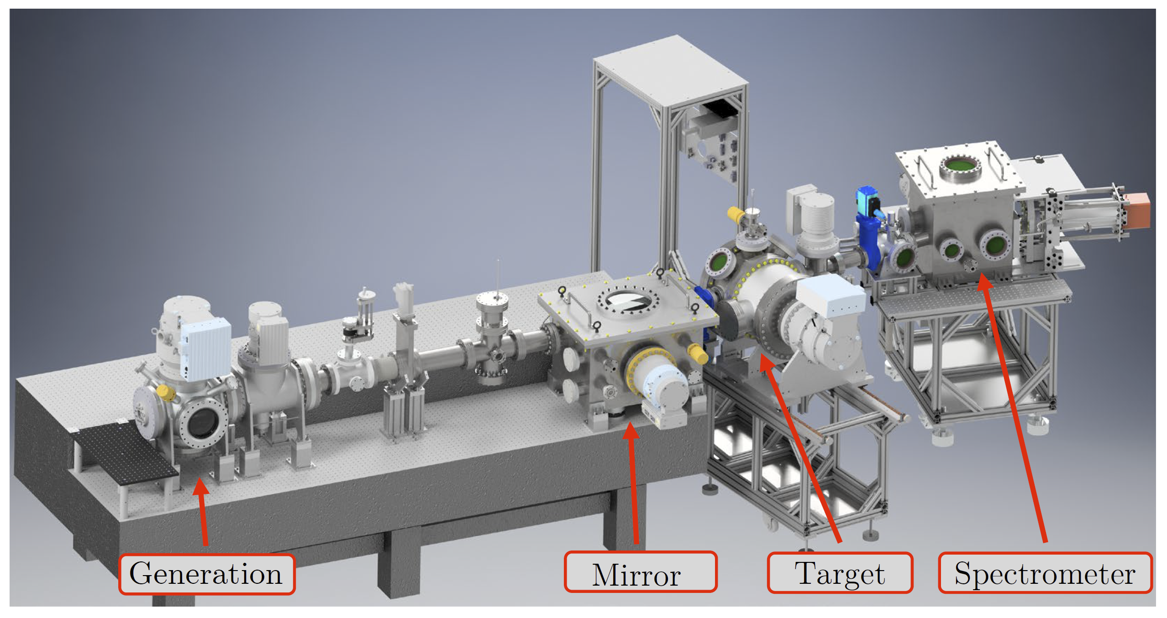
Transient Absorption Beamline (TABLe)

Slide 12
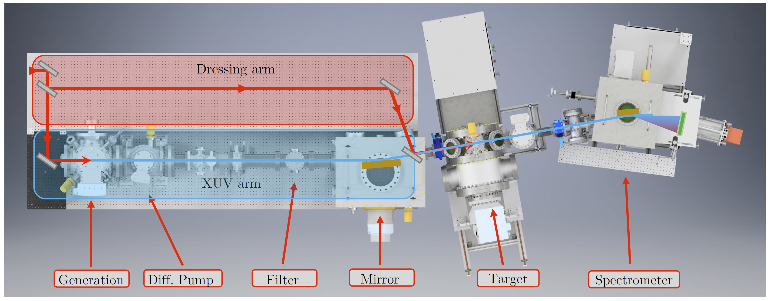
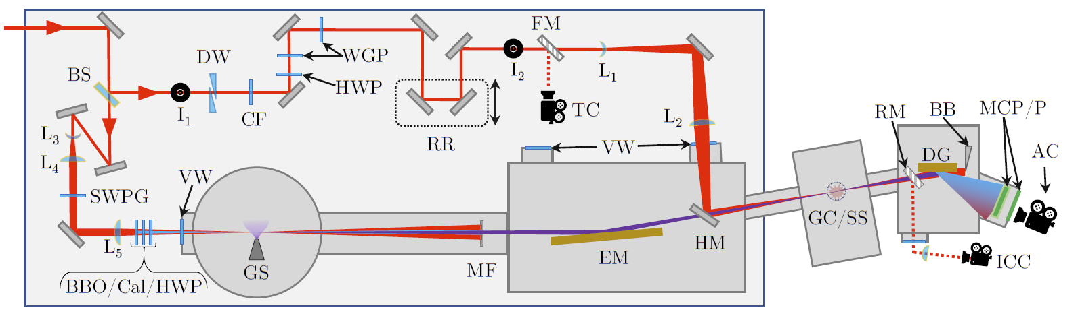
Transient Absorption Beamline (TABLe)
TOPAS
1300 – 1550 nm, 60 fs, 3 mJ, 1 kHz

Slide 13
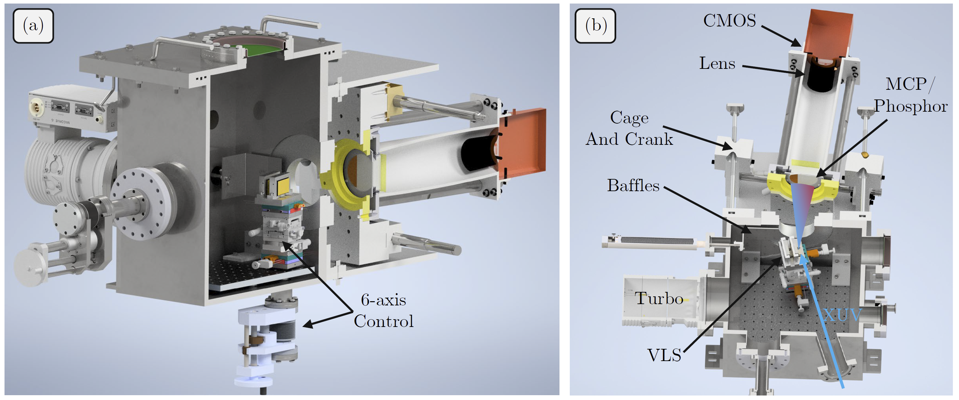
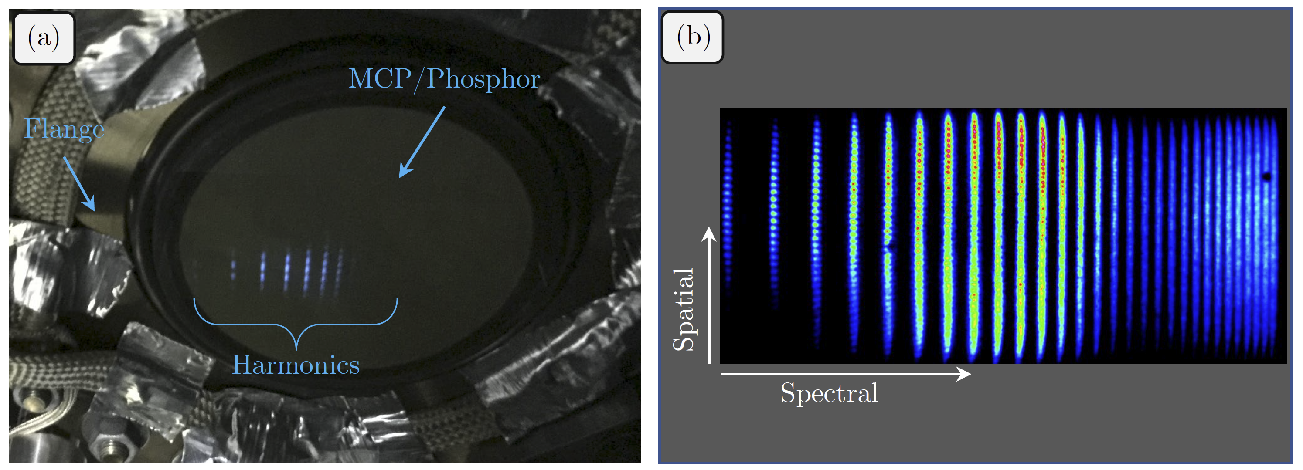
TABLe Photon Spectrometer
Photon spectrometer allows for the measurement of harmonics in the energy range 25-1240 eV
Cage and crank design allows for the MCP/phosphor detector to be positioned along the flat-field of both gratings
VLS grating only focus in one-dimension, thus the spatial profile can be measured as a function of photon energy

Slide 14
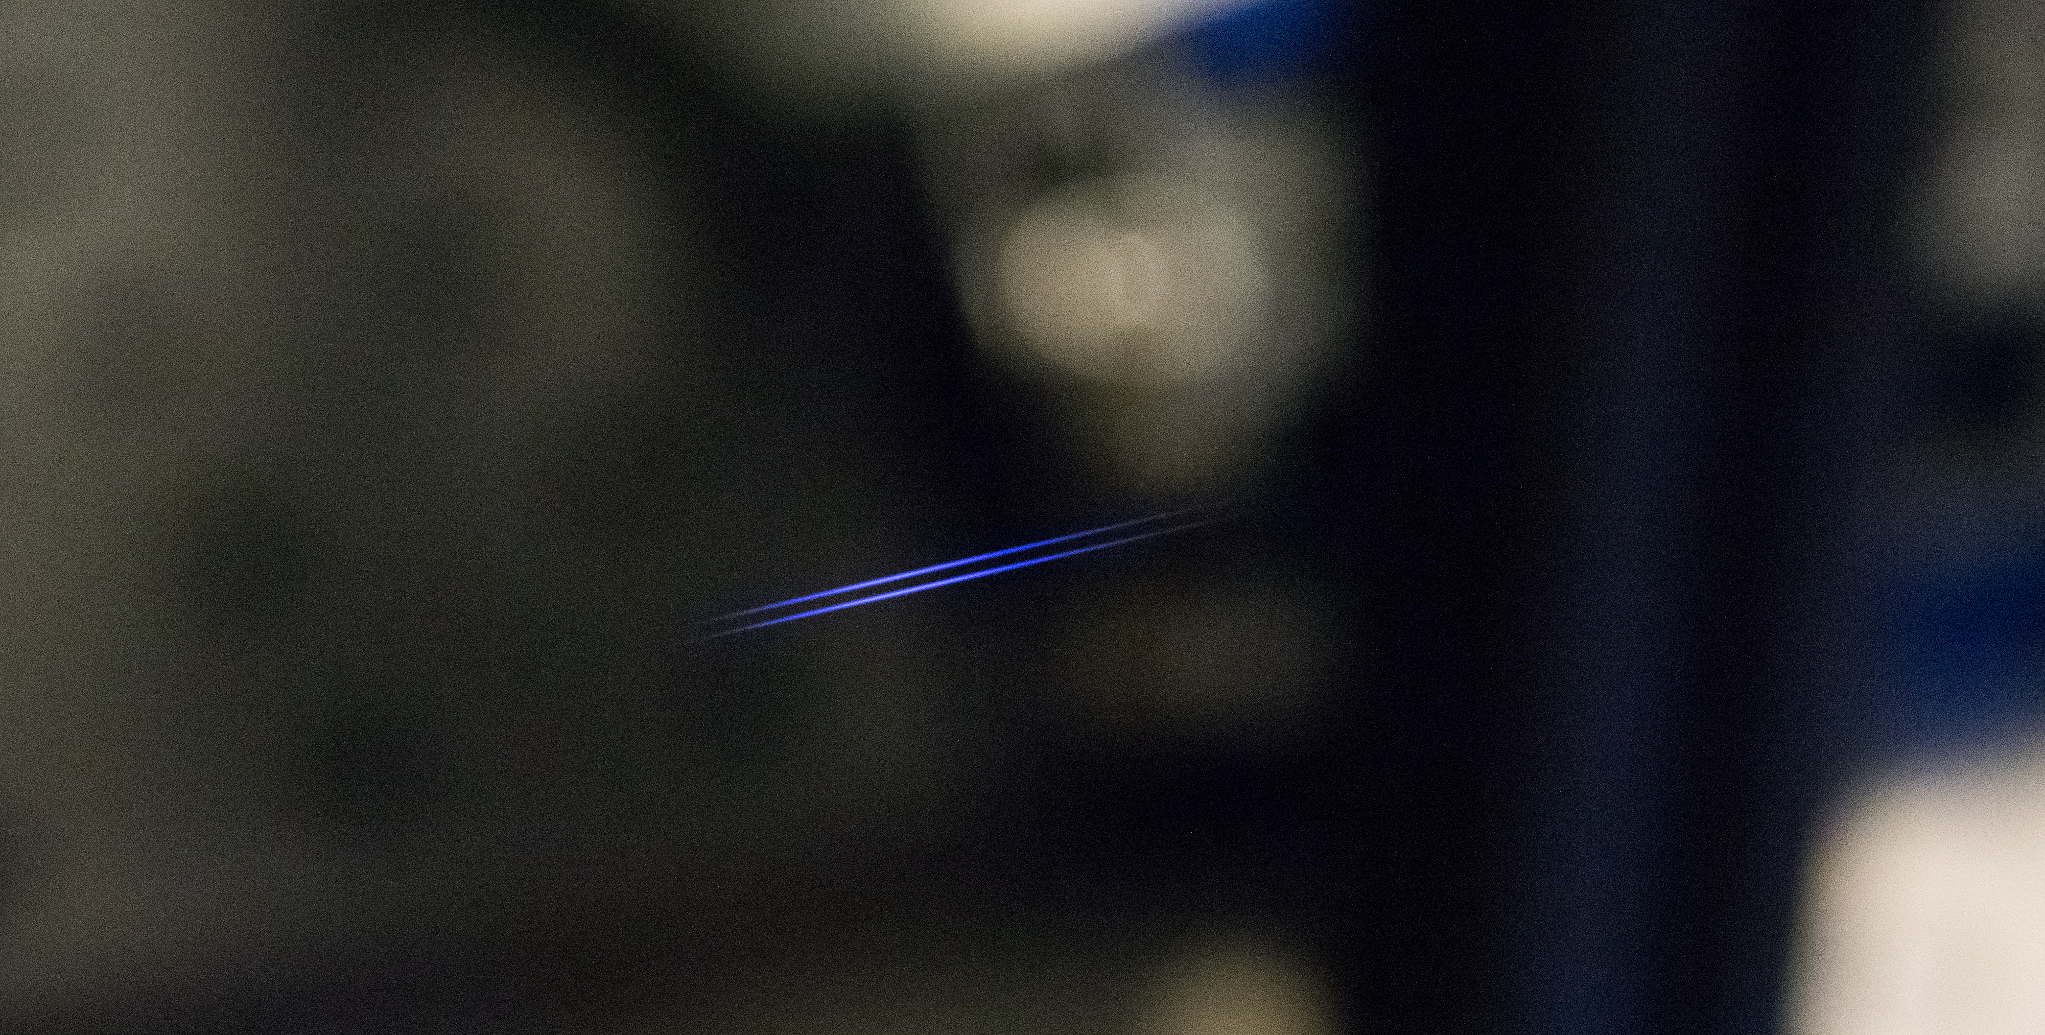
Two-source high-harmonic generation

Slide 15
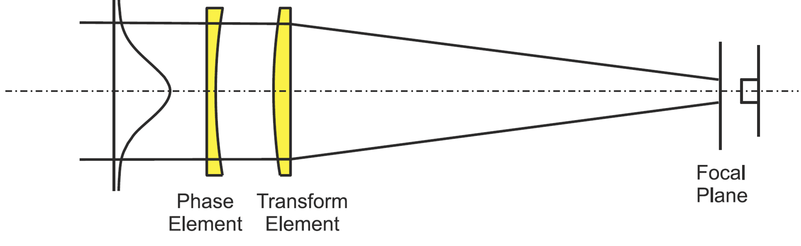
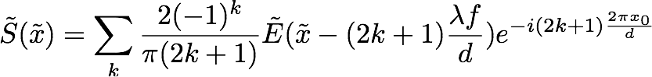
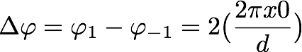
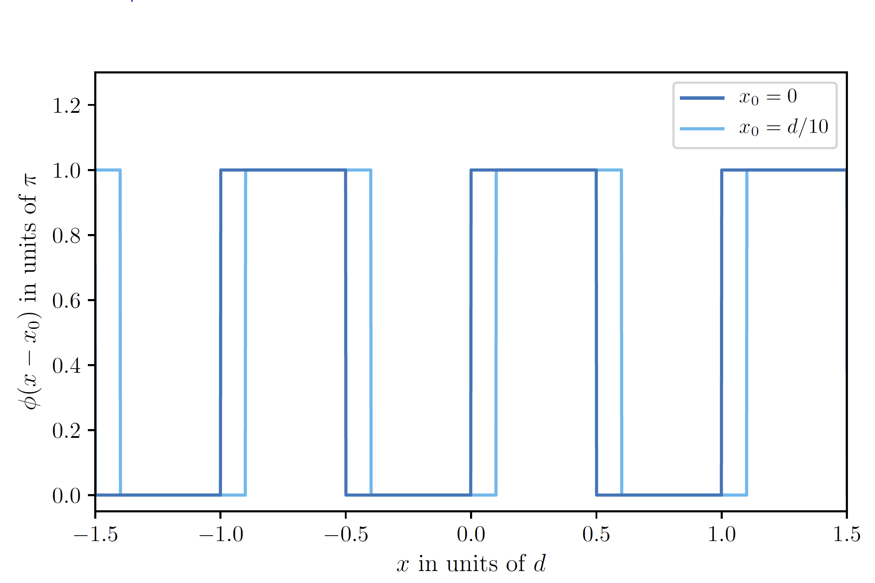
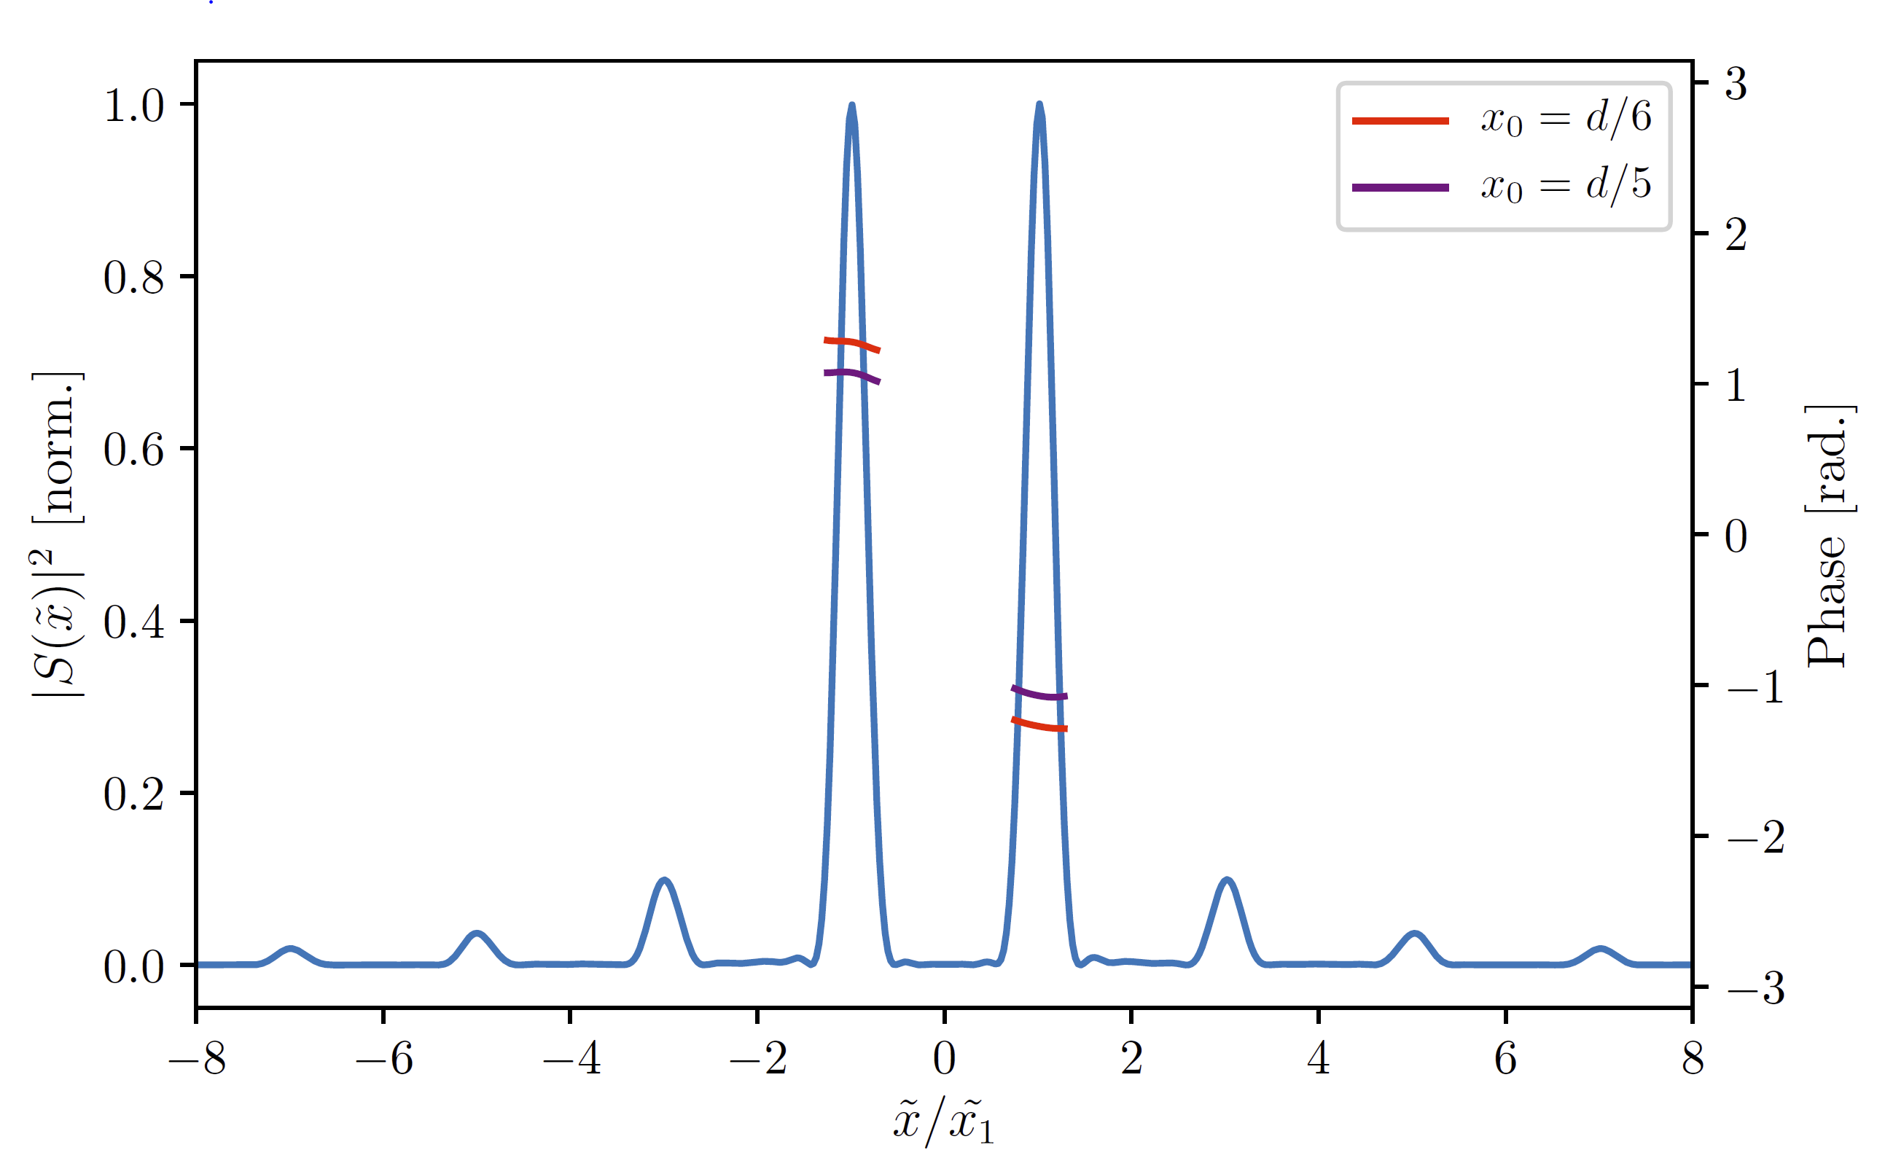
Square-Wave Phase Grating (SWPG)
Field at the focus
Relative phase between ±1 orders
Beam shaping is done using a square wave phase grating
This allows us to two create two duplicates of the input IR field, and each will generate XUV
The phase grating allows for high-precision control over the relative phase between the two sources

Slide 16
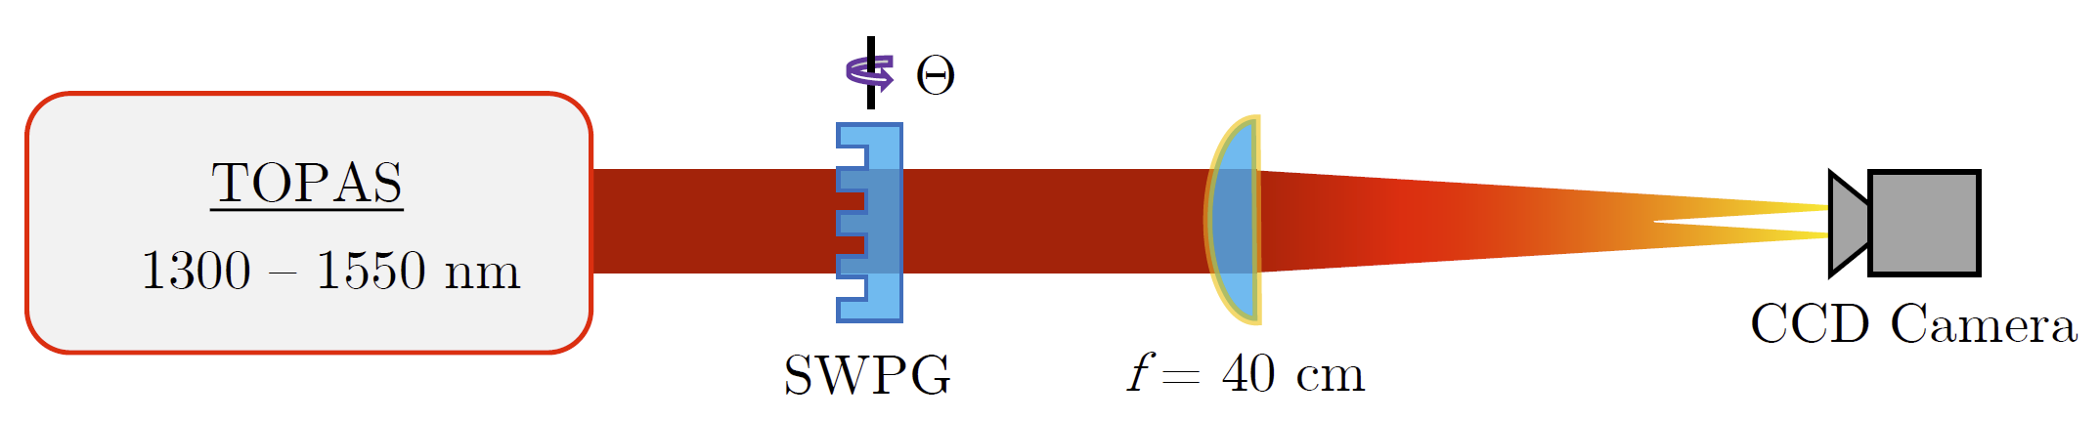
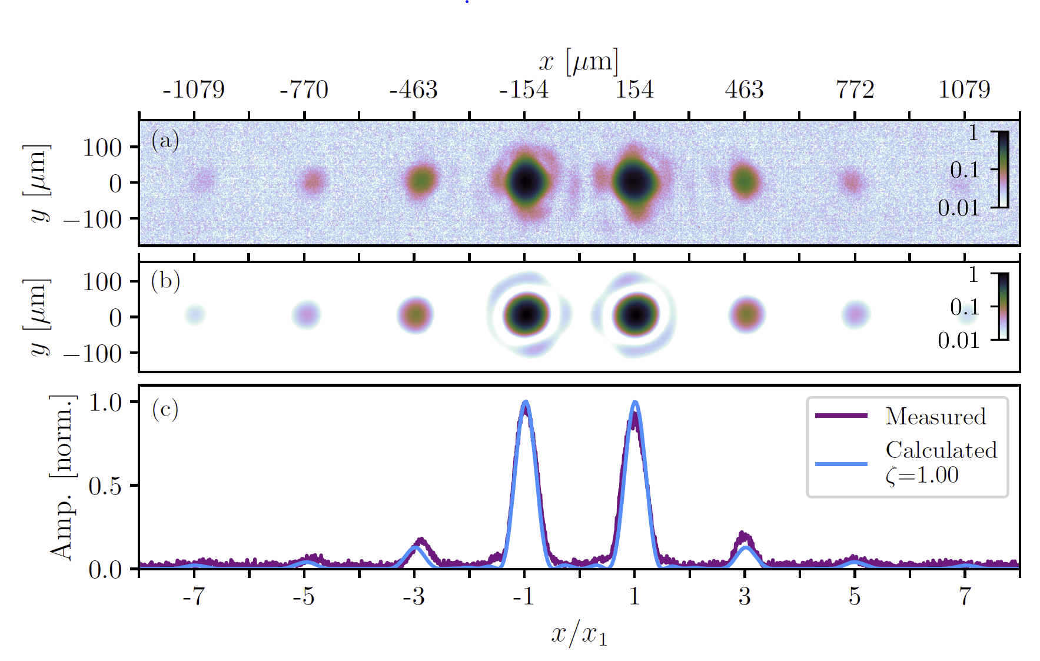
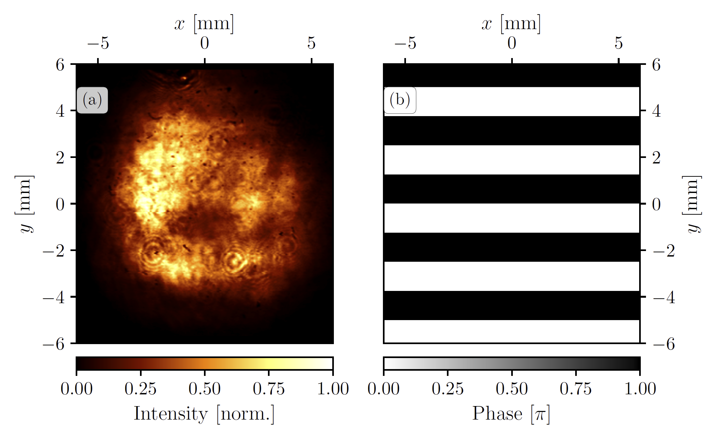
SWPG Beam Profile Measurement
Beam profile at the focal plane can be measured using a CCD camera
Shows excellent agreement between measured beam and the calculated
Demonstrates that the SWPG can be used as a “duplicator”
Only measures intensity, so relative phase control needs to be demonstrated in another way → HHG

Slide 17
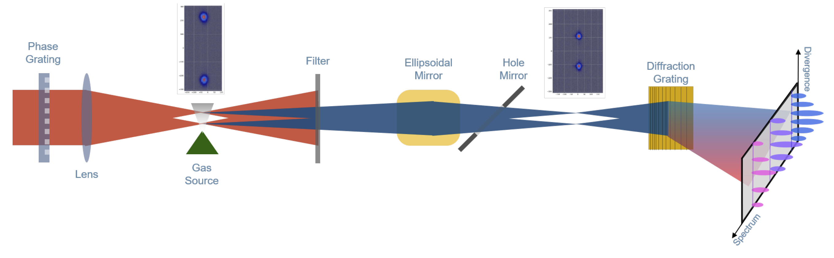
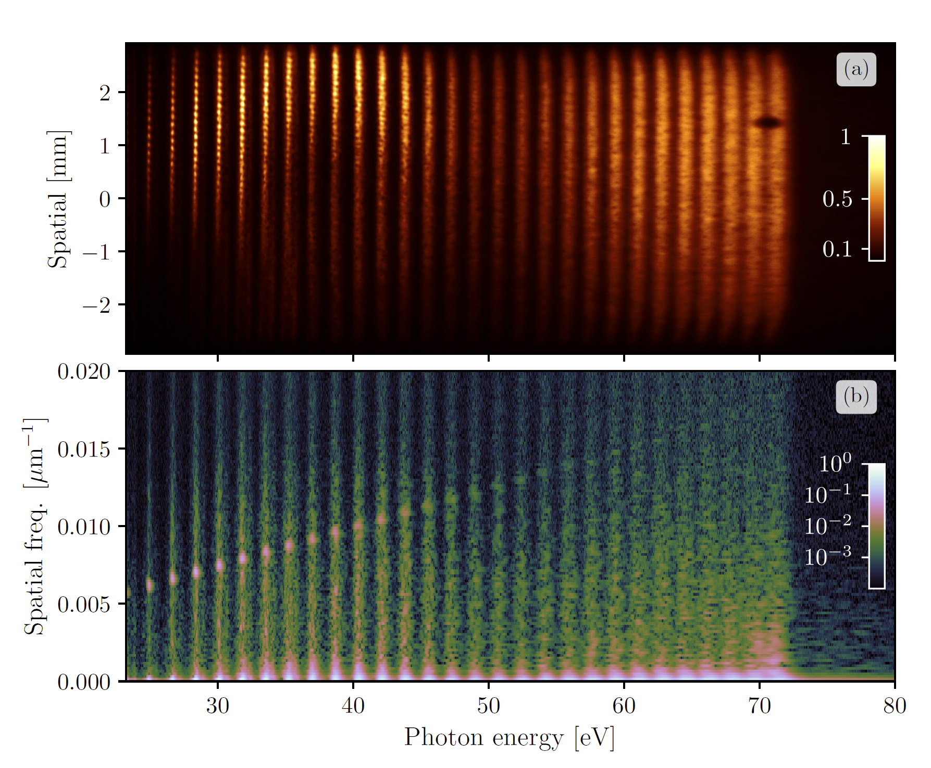
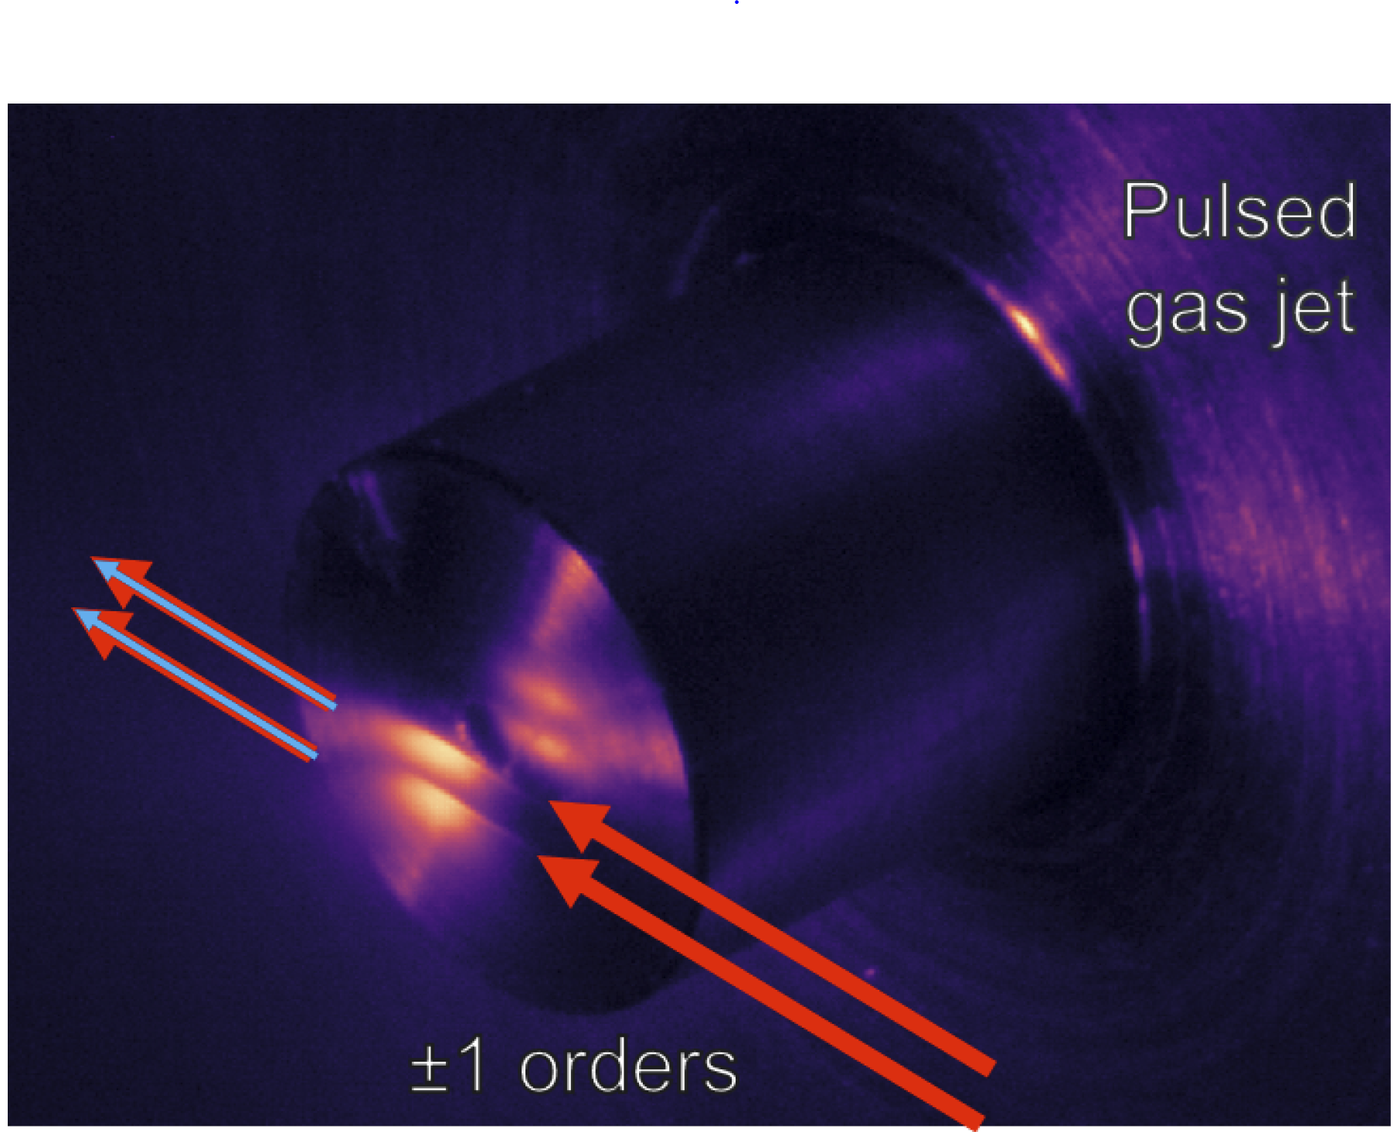
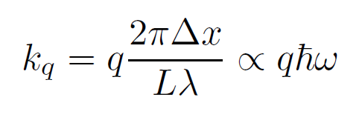
Two-source HHG

Slide 18
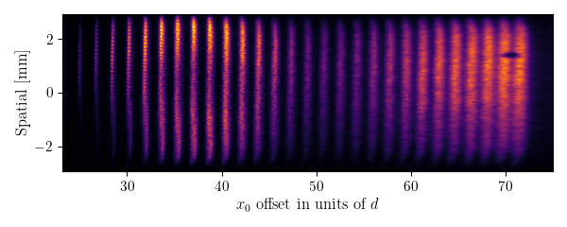
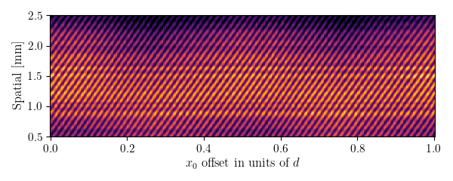
Phase control using SWPG
Translation of grating
in transverse plane
Phase shift
between sources
Fringe shift in
diffraction pattern
SWPG creates what is essentially a single optic interferometer, which means that the interferometric stability is extremely high
This stability means that small phase shifts between the two sources can be measured as a fringe shift in the diffraction pattern

Slide 19
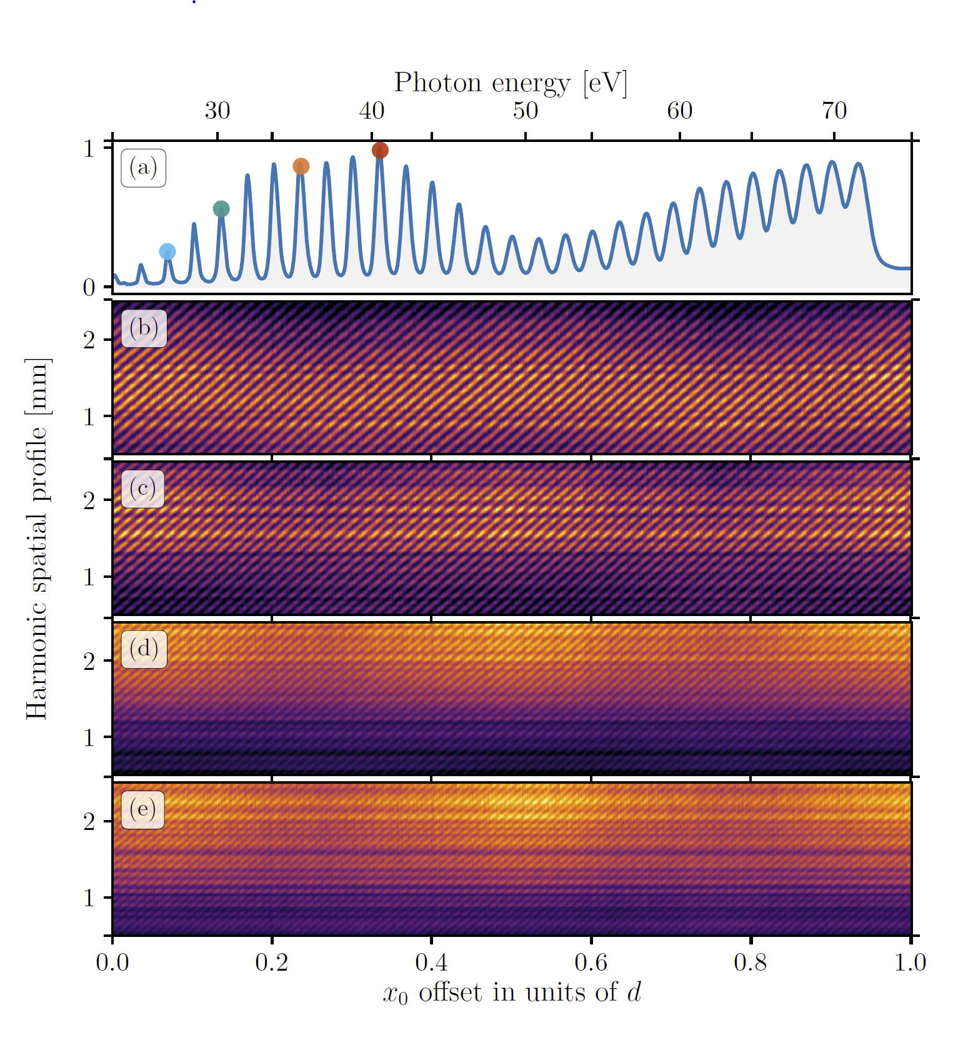
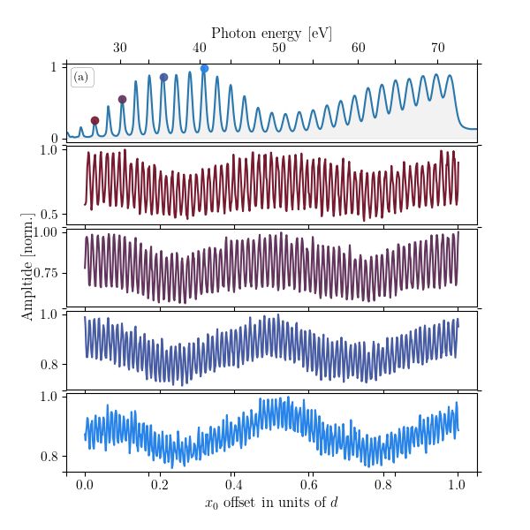
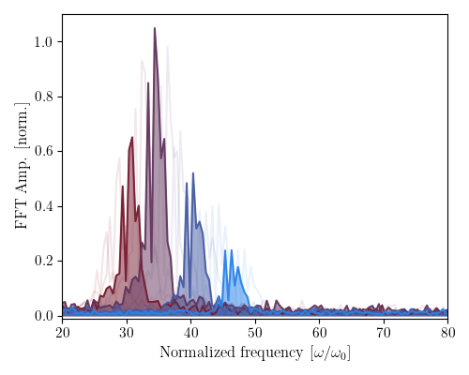
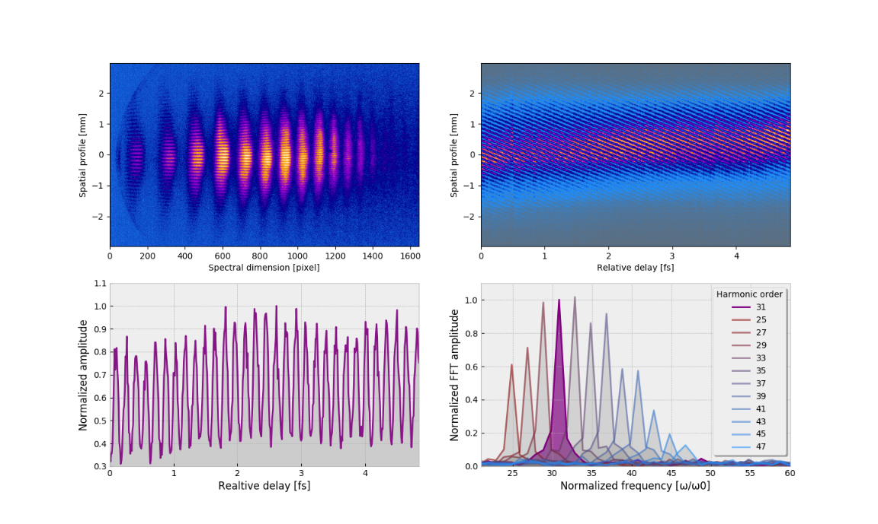
Phase control using SWPG
Fourier transforming shows the dependence on harmonic order → allows for direct measurement of harmonic order q
Ability to measure the harmonic order q from the spatialgram verifies that the SWPG is able to control the phase difference between the two IR sources with a precision of a few mrad

Slide 20
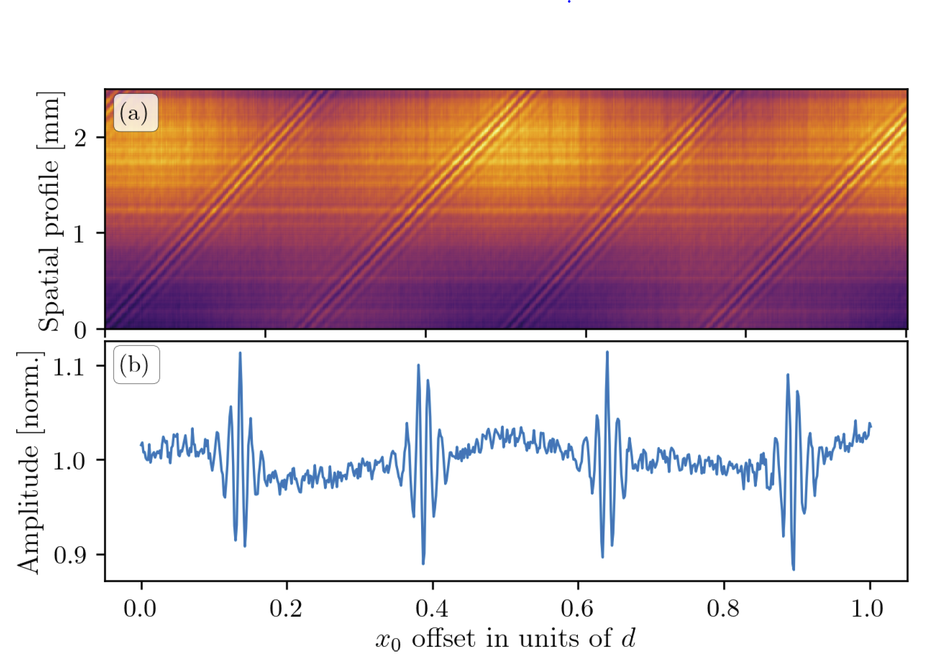
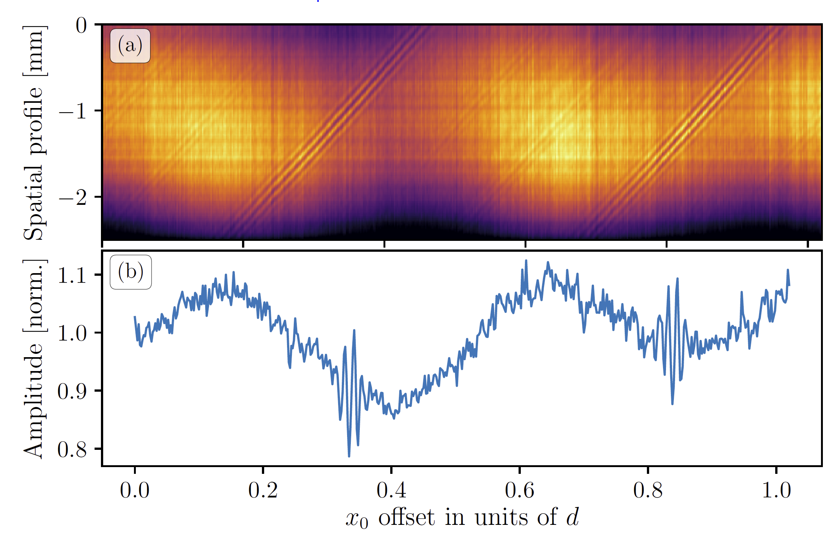
Interferometric autocorrelation using SWPG
Odd
Even/Odd
By combining all harmonics either numerically or by looking at the 0th order diffraction, one recovers the interferometric autocorrelation of the XUV APT
Symmetry of the APT can be seen clearly with one color and two color generation conditions
In principle, this enables one to do Fourier transform spectroscopy with a resolution of ω/2
Limited by interference between the two sources

Slide 21
Two-source HHG using SWPG: conclusion and outlook

Slide 22
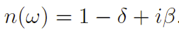
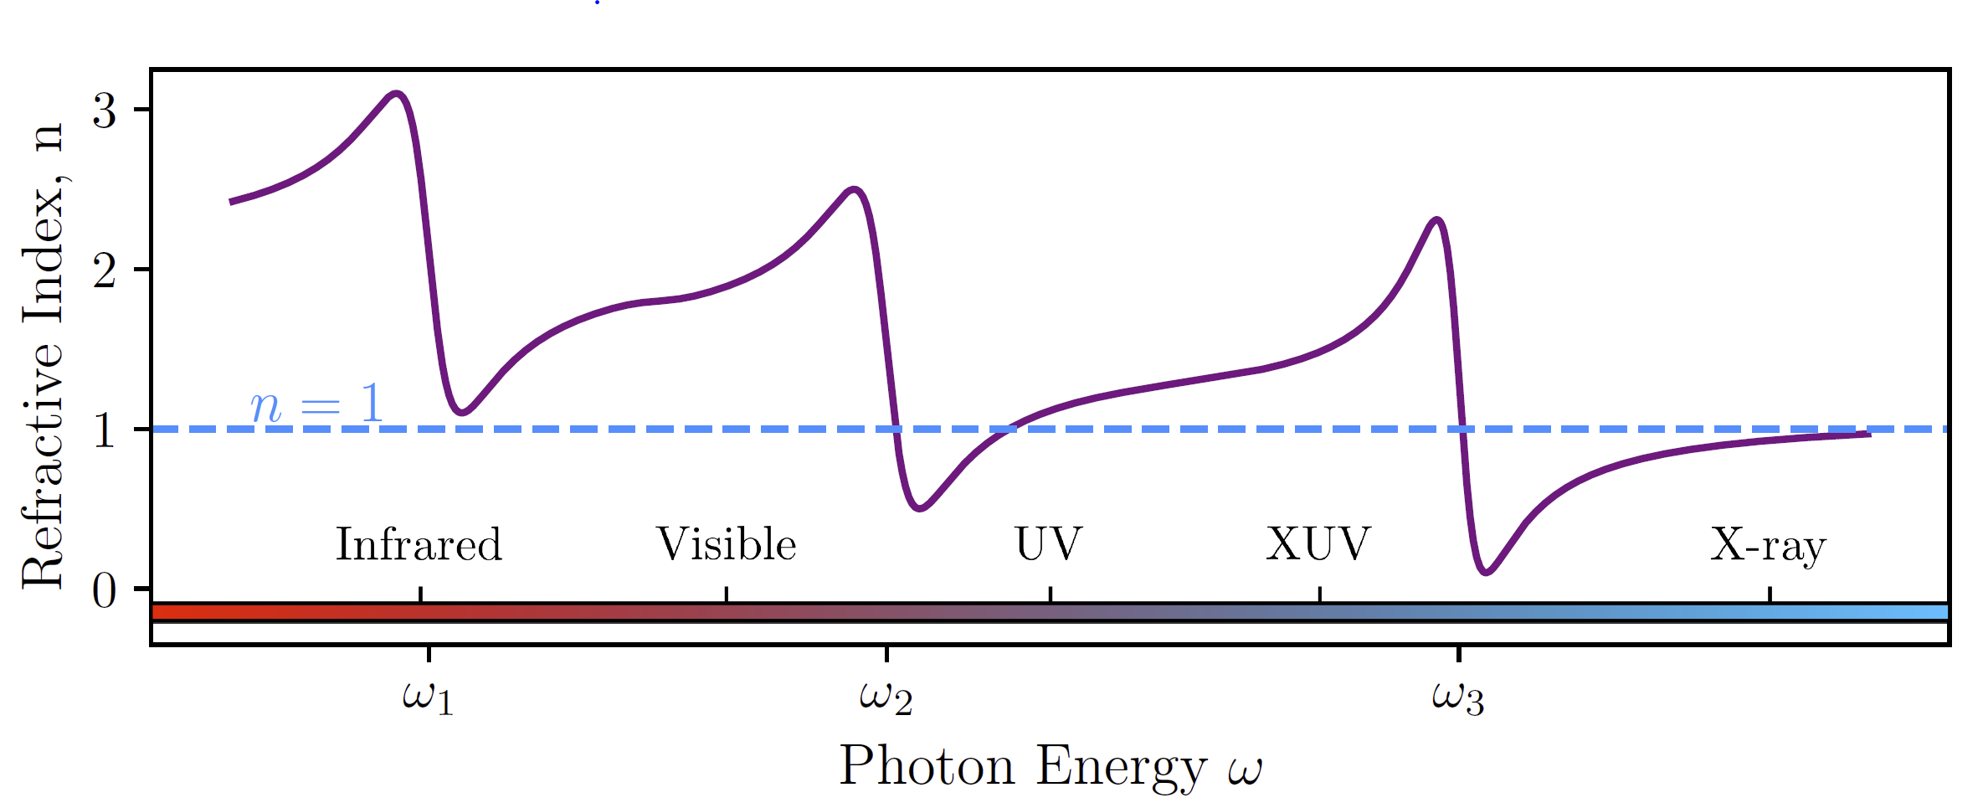
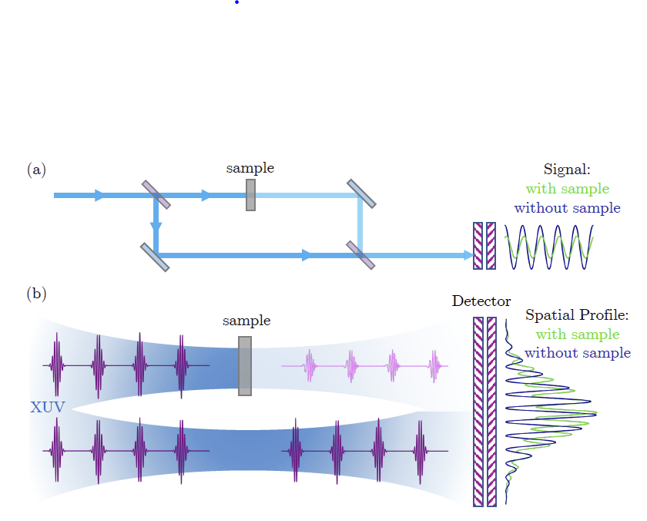
Complex refractive index
E_{in}
E_{out}
n(ω)
absorption
dispersion
Complex refractive index describes the dispersion and absorption of light as it passes through a medium
Measuring both is difficult in the XUV/X-ray regime → one method is interferometric
Demonstrate how the SWPG can be used to measure both parts in the XUV regime

Slide 23
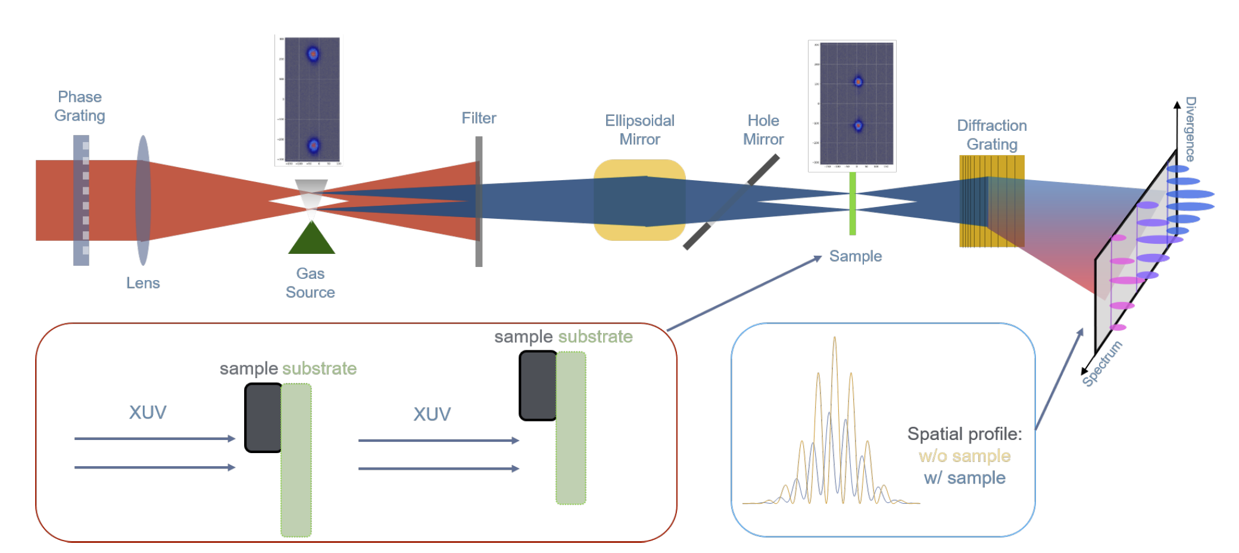
Complex refractive index
SWPG was shown to be sensitive to phase shifts between the two sources → inline interferometer
Introducing a sample into one source will lead to a change in fringe contrast and fringe shift → this enables measurement of n

Slide 24
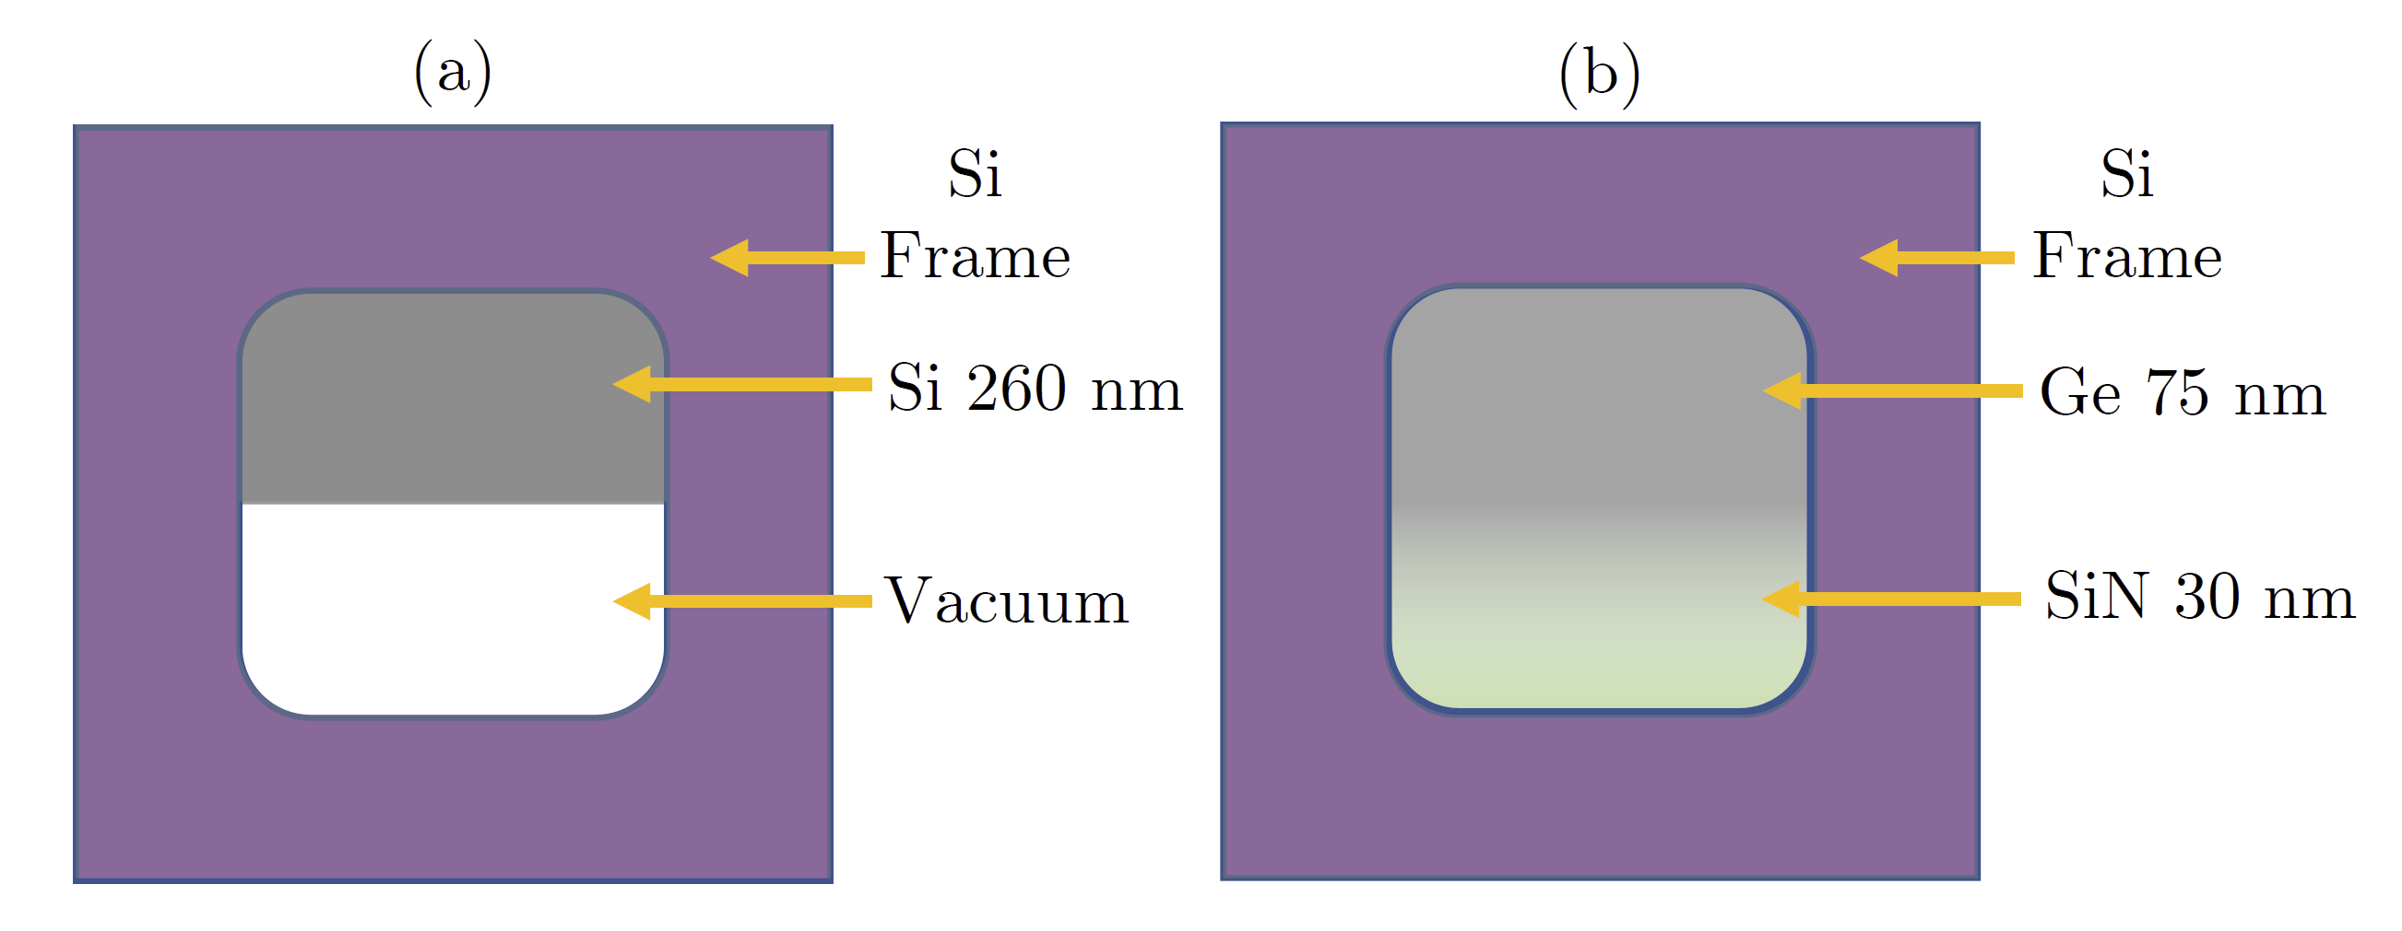
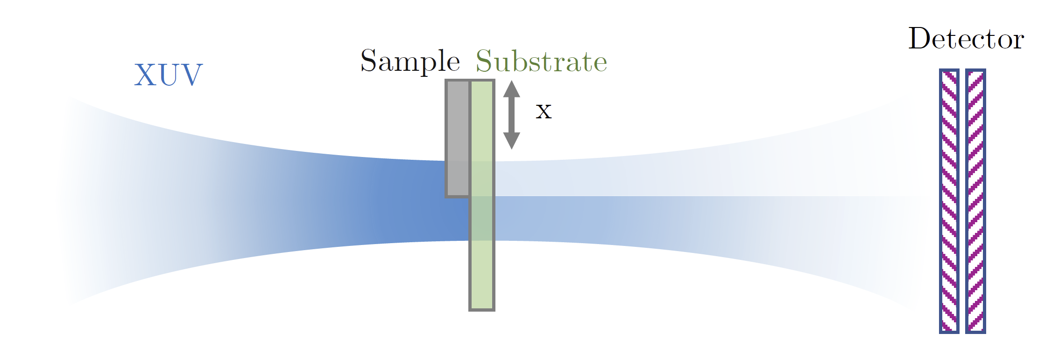
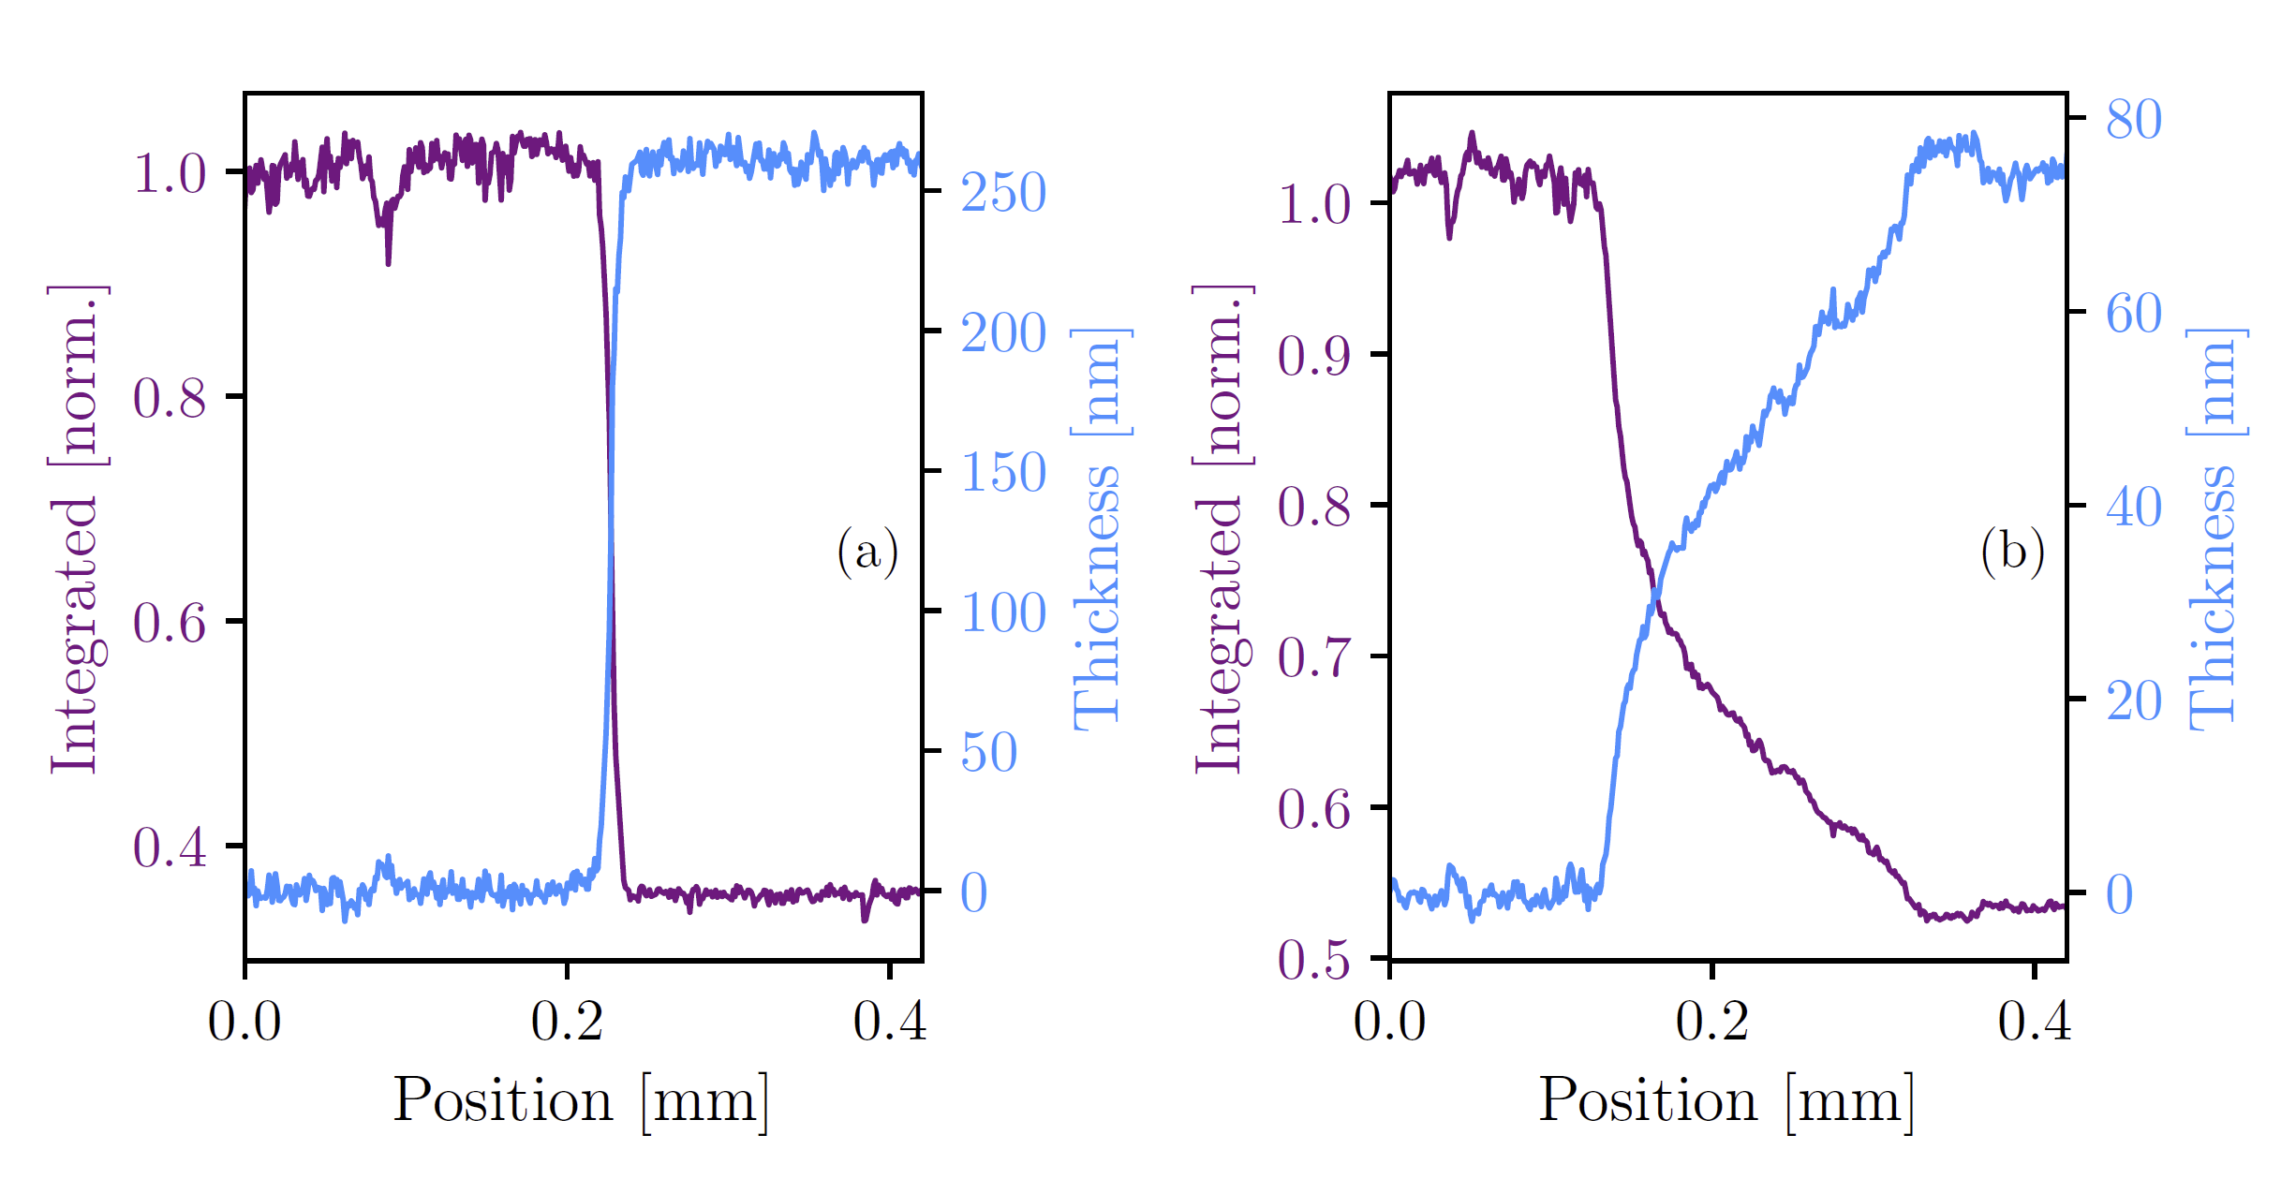
Silicon and germanium samples
Sample must only go through one source → step-like profile
Needs to be free-standing or patterned on a free-standing membrane
Silicon sample is free standing and cleaved in half
Germanium sample was grown on SiN membrane
Knife-edge measurement can be used to measure the profile of each sample

Slide 25
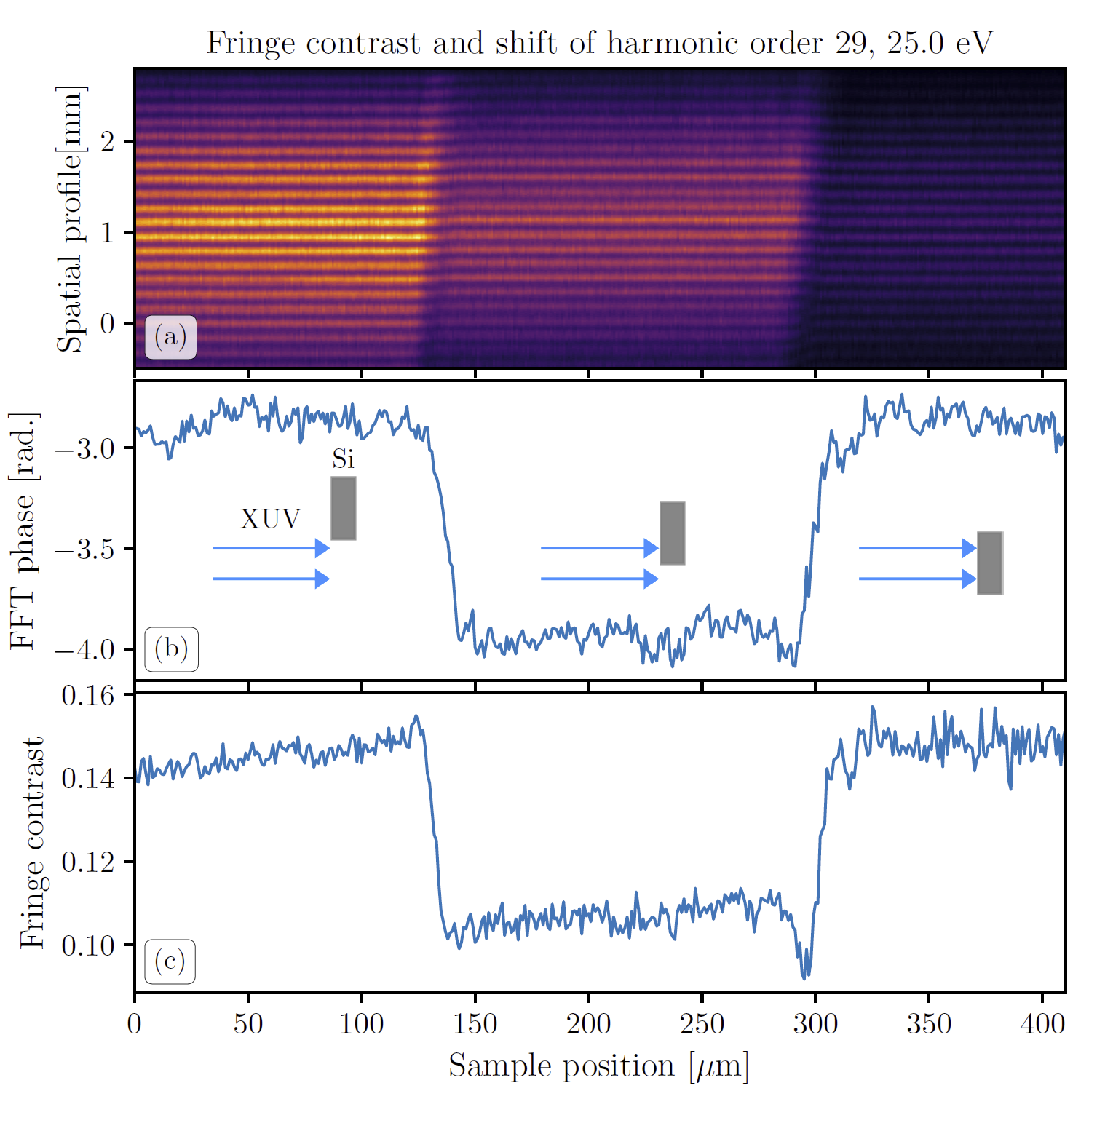
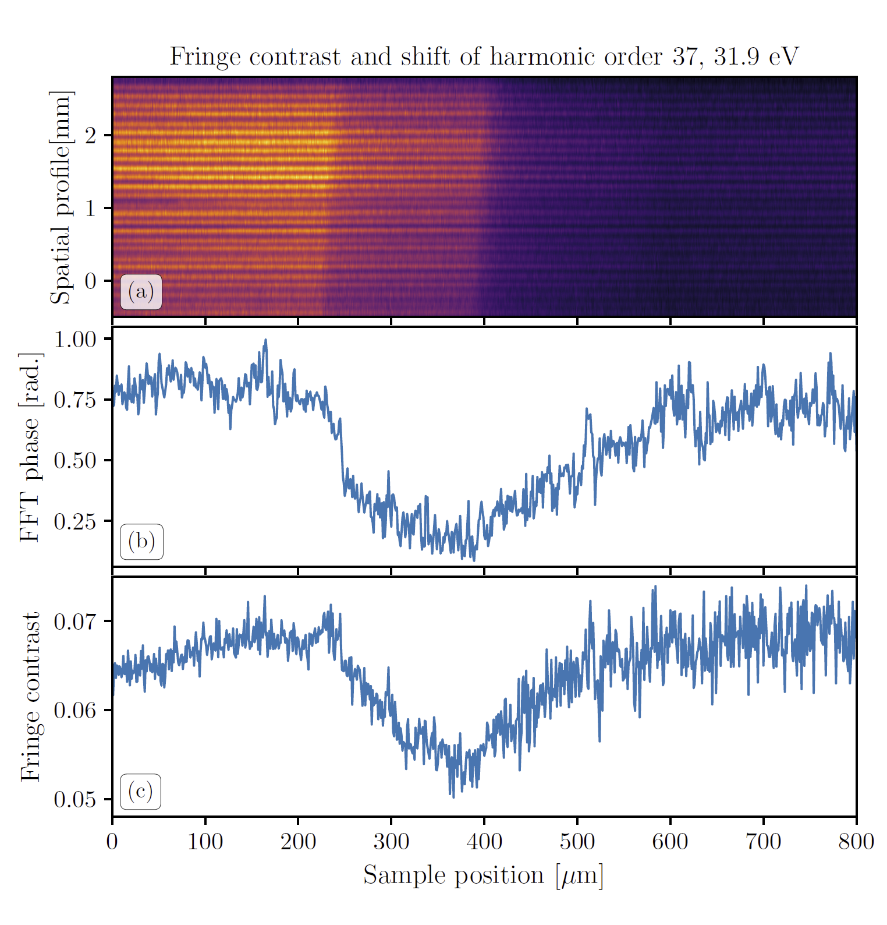


Complex refractive index
Silicon
Germanium
Translating the sample through the two sources shows three distinct regimes
Only when one of the sources goes through the sample is a change in fringe contrast and fringe shift observed, as expected
Confirms that the change in fringe contrast and fringe shift is due to the sample
Real and imaginary parts of refractive index can be calculated from this, however the SWPG allows for further measurements

Slide 26



Fourier transform spectroscopy (FTS)
SWPG allows for control of relative phase between two sources → interferogram
Relative phase can be interpreted as a relative delay between the two sources
Scanning SWPG when only one of the two sources is going through the sample exhibits a shift due to the sample
This is effectively a FTS measurement using the SWPG

Slide 27





Fourier transform spectroscopy (FTS)
Silicon
Fourier Trans.
1 → sample/no sample
2 → no sample/no sample
Germanium
Phase shift and transmission due to sample can be measured

Slide 28


Complex refractive index
Silicon
Germanium
Finally, real and imaginary parts are calculated for both materials
Shows excellent agreement with literature results for both silicon and germanium
Demonstrates that the SWPG can be used to measure the ground state of a material far from an absorption edge (Si) and near an absorption edge (Ge)

Slide 29
Two-source HHG using SWPG: conclusion and outlook

Slide 30

Attosecond Transient-absorption Spectroscopy (ATS)

Slide 31



Fano resonances in argon

Slide 32


Fano resonances

Slide 33

Fano resonances in time

Slide 34



Dipole Control Model (DCM)

Slide 35


Slide 36



Slide 37




Slide 38


Slide 39


Slide 40


Slide 41
Two-source HHG using SWPG: conclusion and outlook

Slide 42





Complex Attosecond Transient-absorption Spectroscopy (CATS)
SWPG was shown to be sensitive to phase shifts between the two sources → inline interferometer
Introducing a dressing pulse into one source will lead to a change in fringe contrast and fringe shift → this enables measurement of real and imaginary refractive index

Slide 43


CATS delay dependence
Fringe shift and fringe contrast used to extract ΔOD and Δφ
Extracted ΔOD shows good agreement with typically measured ΔOD
Two intensities show a clear difference in features near 4p and 6p resonances
Δφ shows the emergence of a LIS near overlap at the higher intensity

Slide 44


CATS vs. Kramers-Kronig (KK)
KK relations can be used to retrieve one part of the refractive index from another
Indirect method that doesn’t always apply
Using the non-linear KK, good agreement is found at low intensity
Two methods disagree at higher intensities
Further theoretical efforts are required

Slide 45



Polarizability and dipole extraction
Finally, the amplitude and phase of the polarizability can be extracted from the complex refractive index
In principle, the dipole can be extracted from this with knowledge of the XUV phase

Slide 46
Thank you for your attention!

Slide 49




Slide 50

H31
H31
H31

Slide 51


Slide 52




